Slide 1
Embeddings

Slide 2
The wonderful world of embeddings!

Slide 3
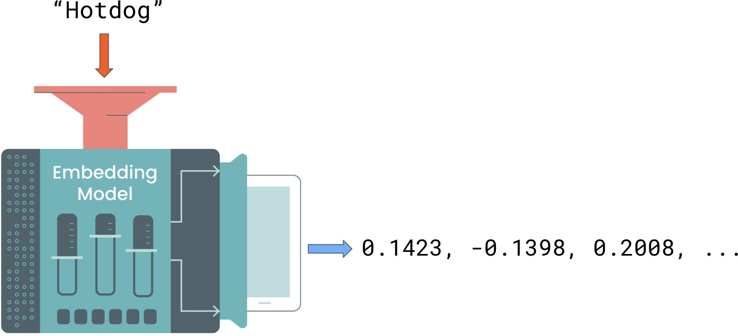
What are embeddings?
Concept from Natural Language Processing (NLP) Numerical representation of text

Slide 4
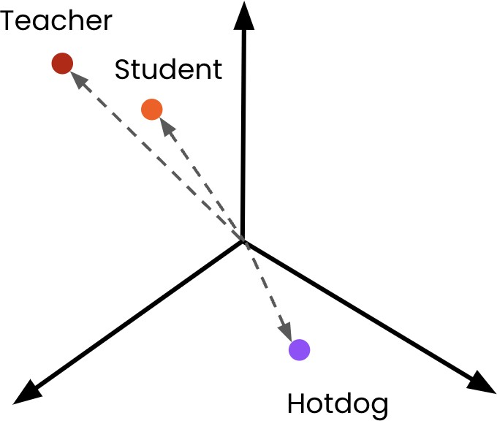
What are embeddings?
Text is mapped onto a multi-dimensional
vector space
The numbers outputted by the model are the text's location in the space
Similar words appear closer together
Dissimilar words appear further away

Slide 5
Why are embeddings useful?
Embeddings allow semantic meaning to be captured
Semantic meaning: context and intent behind text
Example:
"Which way is it to the supermarket?"
"Could I have directions to the shop?"

Slide 6
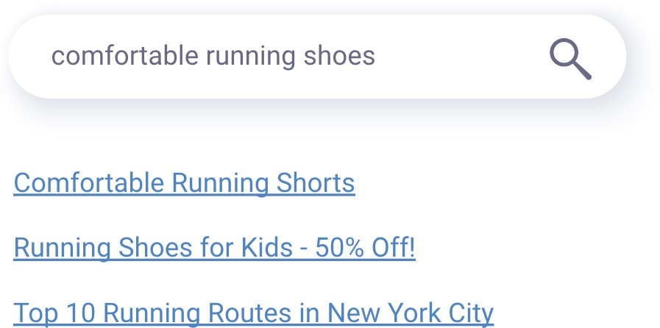
Semantic search engines
Traditional search engines
Use keyword pattern matching
May miss the true intent Will miss word variations

Slide 7
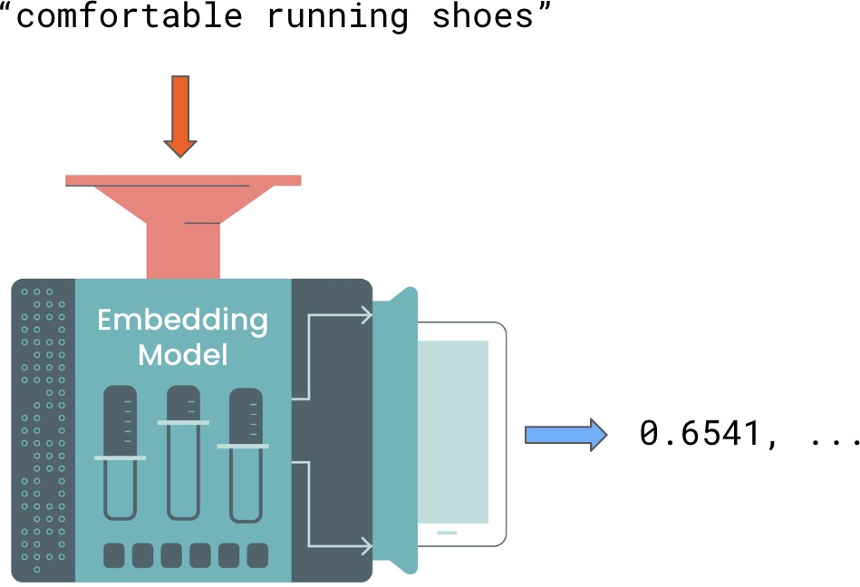
Semantic search engines
Use embeddings to understand intent and context

Slide 8
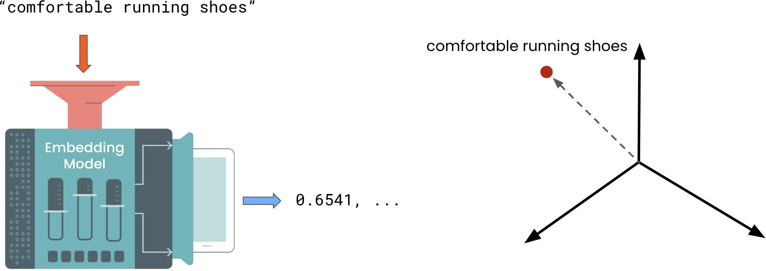
Semantic search engines
Use embeddings to understand intent and context

Slide 9
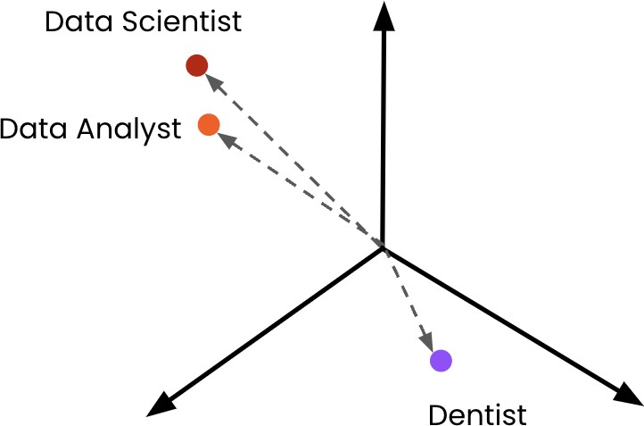
Recommendation systems
Example: Job post recommendations Recommend jobs based on descriptions already viewed
Mitigates variations in job title

Slide 10
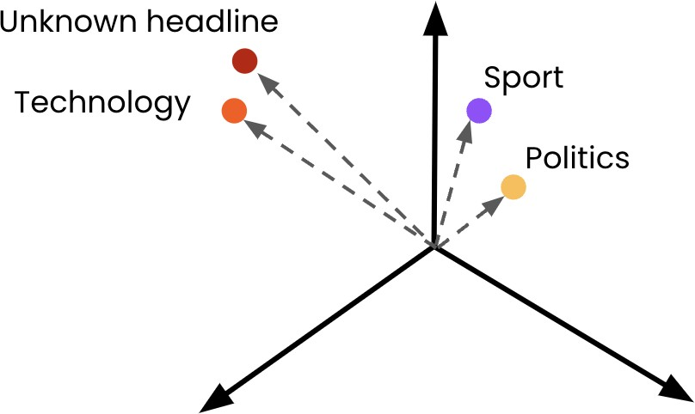
Classification
Classification tasks:
Classify sentiment Cluster observations Categorization
Example:
Classifying news headlines

Slide 11
Creating an Embeddings request
Embeddings endpoint
from openai import OpenAI
client = OpenAI(api_key="<OPENAI_API_KEY>") response = client.embeddings.create(
model="text-embedding-3-small",
input="Embeddings are a numerical representation of text that can be used to measure the relatedness between two pieces of text."
)
response_dict = response.model_dump() print(response_dict)

Slide 12
Embeddings response
{'object': 'list', 'data': [
{
"embedding": [0.0023064255, ..., -0.0028842222],
"index": 0, "object": "embedding"
}
],
'model': 'text-embedding-3-small', 'usage': {
"prompt_tokens": 24,
"total_tokens": 24
}
}

Slide 13
Extracting the embeddings
print(response_dict['data'][0]['embedding'])
[0.0023064255, ...., -0.0028842222]

Slide 14
Investigating the Vector Space

Slide 15
Example: Embedding headlines
articles = [
{"headline": "Economic Growth Continues Amid Global Uncertainty", "topic": "Business"},
{"headline": "Interest rates fall to historic lows", "topic": "Business"},
{"headline": "Scientists Make Breakthrough Discovery in Renewable Energy", "topic": "Science"},
{"headline": "India Successfully Lands Near Moon's South Pole", "topic": "Science"},
{"headline": "New Particle Discovered at CERN", "topic": "Science"},
{"headline": "Tech Company Launches Innovative Product to Improve Online Accessibility", "topic": "Tech"},
{"headline": "Tech Giant Buys 49% Stake In AI Startup", "topic": "Tech"},
{"headline": "New Social Media Platform Has Everyone Talking!", "topic": "Tech"},
{"headline": "The Blues get promoted on the final day of the season!", "topic": "Sport"},
{"headline": "1.5 Billion Tune-in to the World Cup Final", "topic": "Sport"}
]

Slide 16
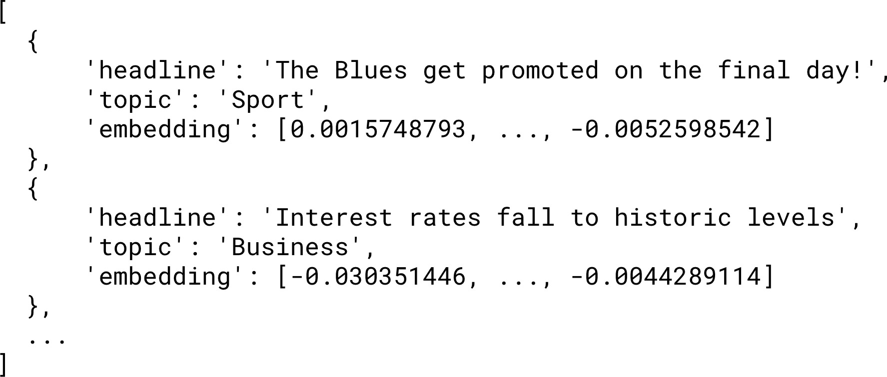
Example: Embedding headlines

Slide 17
Embedding multiple inputs
headline_text = [article['headline'] for article in articles] headline_text
["Economic Growth Continues Amid Global Uncertainty",
...,
"1.5 Billion Tune-in to the World Cup Final"]
response = client.embeddings.create( model="text-embedding-3-small", input=headline_text
)
response_dict = response.model_dump()
Batching is more efficient than using multiple API calls

Slide 18

Embedding multiple inputs
articles = [
{"headline": "Economic Growth Continues Amid Global Uncertainty", "topic": "Business"},
...
]
for i, article in enumerate(articles):
article['embedding'] = response_dict['data'][i]['embedding']
print(articles[:2])
[{'headline': 'Economic Growth Continues Amid Global Uncertainty', 'topic': 'Business',
'embedding': [-0.017142612487077713, ..., -0.0012911480152979493]}
{'headline': 'Interest rates fall to historic lows', 'topic': 'Business',
'embedding': [-0.032995883375406265, ..., -0.0028605300467461348]}]

Slide 19
How long is the embeddings vector?
"Economic Growth Continues Amid Global Uncertainty"
len(articles[0]['embedding'])
1536
"Tech Company Launches Innovative Product to Improve Accessibility"
len(articles[5]['embedding'])
1536
Always returns 1536 numbers!

Slide 20
Dimensionality reduction and t-SNE
Various techniques to reduce the number of dimensions
t-SNE (t-distributed Stochastic Neighbor Embedding)

Slide 21
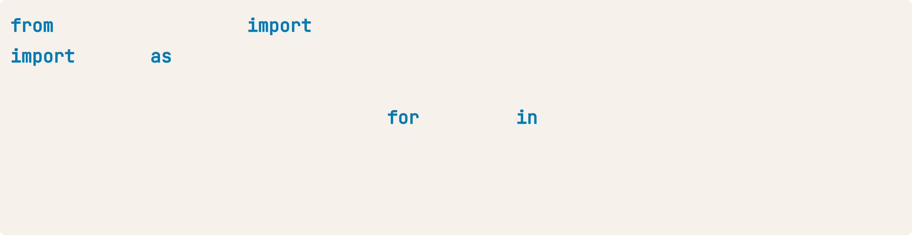
Implementing t-SNE
from sklearn.manifold import TSNE import numpy as np
embeddings = [article['embedding'] for article in articles] tsne = TSNE(n_components=2, perplexity=5)
embeddings_2d = tsne.fit_transform(np.array(embeddings))
n_components : the resulting number of dimensions
perplexity : used by the algorithm, must be less than number of data points
Will result in information loss

Slide 22
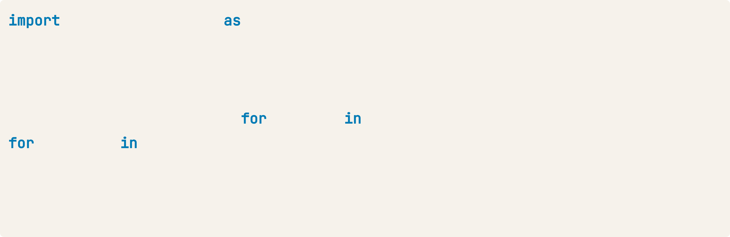
Visualizing the embeddings
import matplotlib.pyplot as plt
plt.scatter(embeddings_2d[:, 0], embeddings_2d[:, 1])
topics = [article['topic'] for article in articles] for i, topic in enumerate(topics):
plt.annotate(topic, (embeddings_2d[i, 0], embeddings_2d[i, 1]))
plt.show()

Slide 23
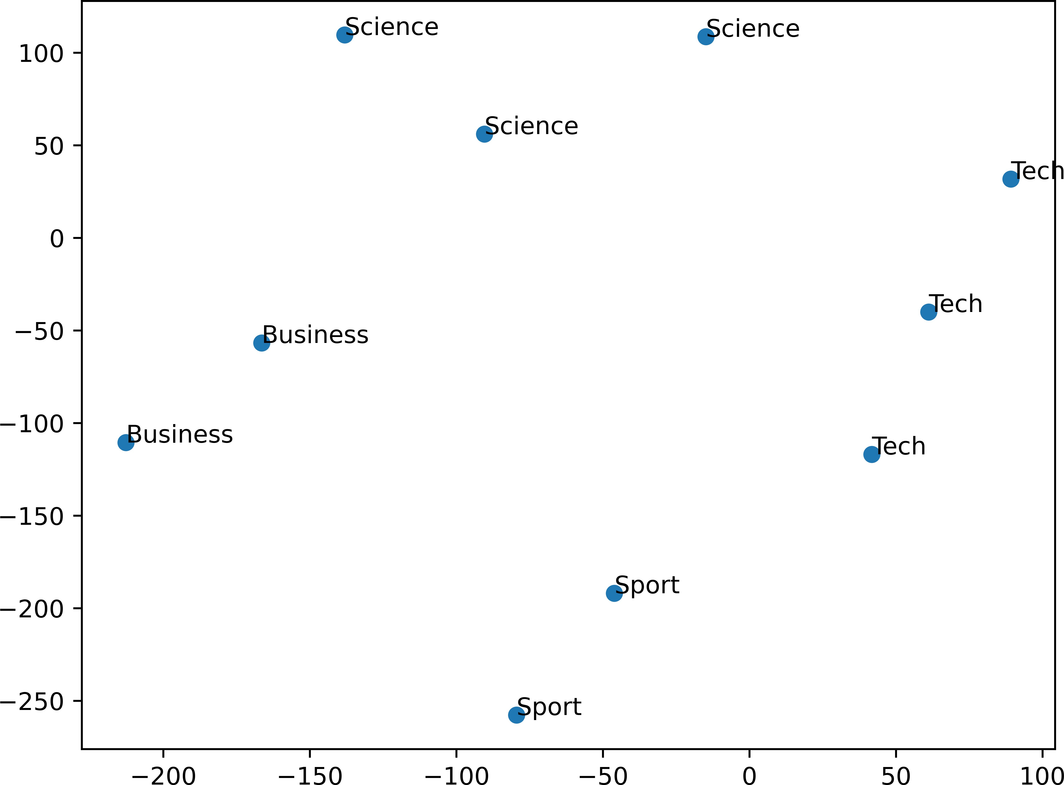
Visualizing the embeddings
Similar articles are grouped together!
Model captured the semantic meaning
Coming up: Computing similarity

Slide 24
Text similarity

Slide 25
Recap...
Semantically similar texts are embedded
more closely in the vector space
Measuring distance allows us to measure similarity
Enables embeddings applications: Semantic search
Recommendations Classification

Slide 26
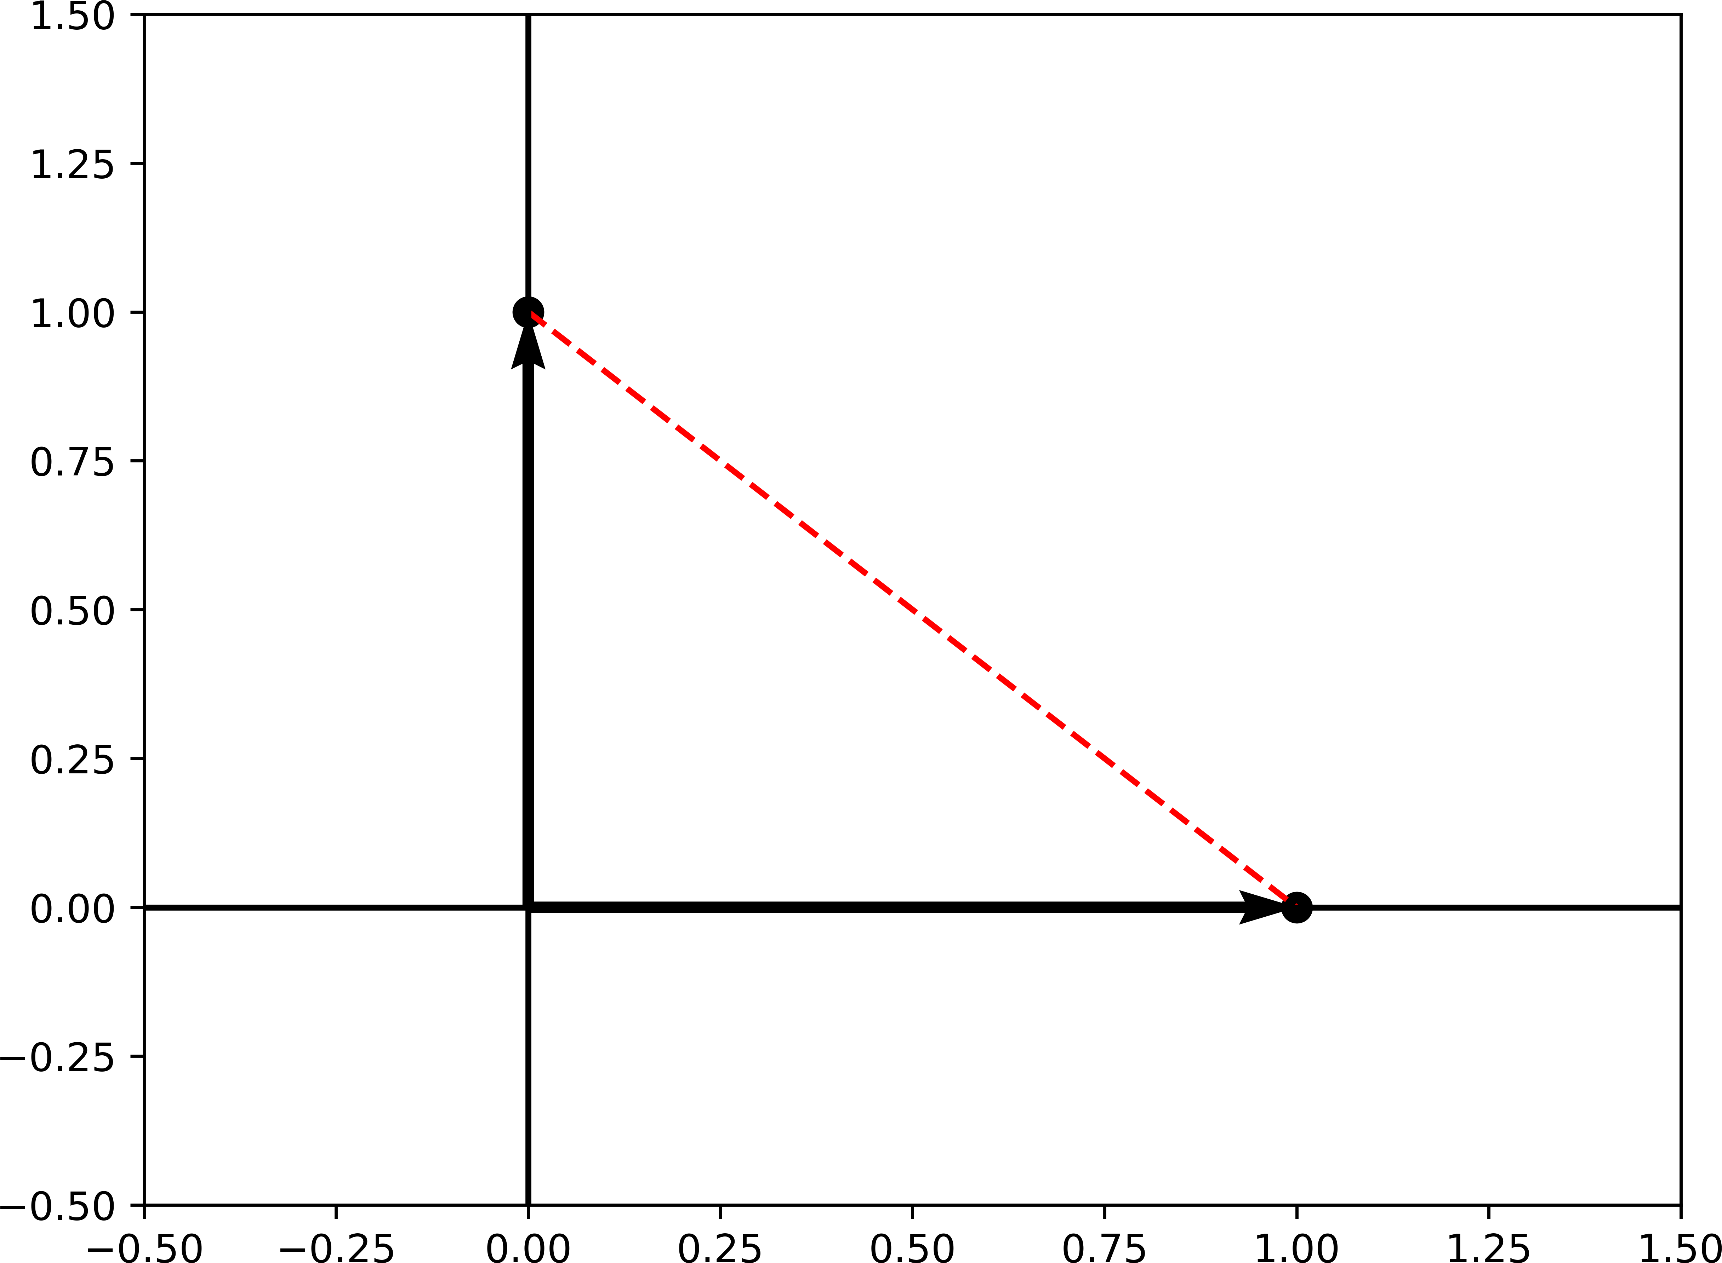
Measuring similarity
Cosine distance
from scipy.spatial import distance distance.cosine([0, 1], [1, 0])
1.0
Ranges from 0 to 2
Smaller numbers = Greater similarity

Slide 27
Example: Comparing headline similarity

Slide 28
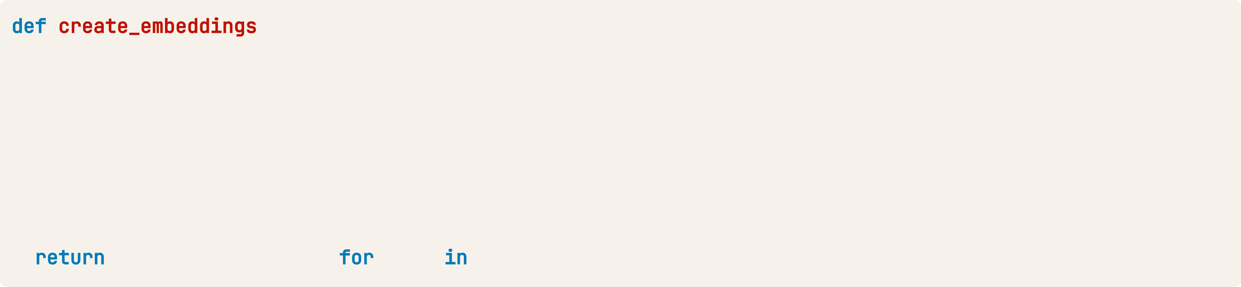
Example: Comparing headline similarity
def create_embeddings(texts):
response = client.embeddings.create( model="text-embedding-3-small", input=texts
)
response_dict = response.model_dump()
return [data['embedding'] for data in response_dict['data']]
print(create_embeddings(["Python is the best!", "R is the best!"])) print(create_embeddings("Trivera is awesome!")[0])
[[0.0050565884448587894, ..., , -0.04000323638319969],
[-0.0018890155479311943, ..., -0.04085670784115791]]
[0.00037010075175203383, ..., -0.021759100258350372]

Slide 29
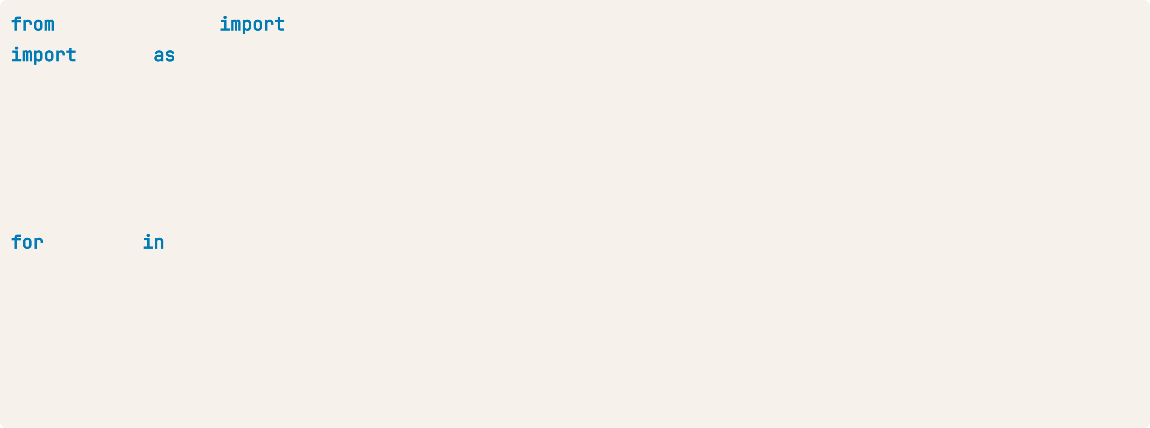
Example: Comparing headline similarity
from scipy.spatial import distance import numpy as np
search_text = "computer"
search_embedding = create_embeddings(search_text)[0]
distances = []
for article in articles:
dist = distance.cosine(search_embedding, article["embedding"]) distances.append(dist)
min_dist_ind = np.argmin(distances) print(articles[min_dist_ind]['headline'])
Tech Company Launches Innovative Product to Improve Online Accessibility

Slide 30
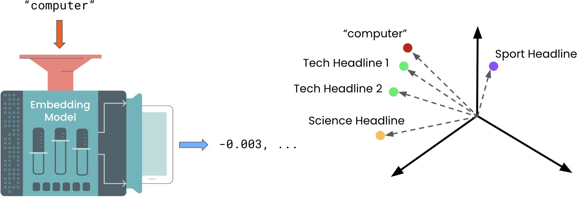
Semantic search
Use embeddings to return most similar results to a search query
Example: Semantic search for online news website

Slide 31
Semantic search
Embed the search query and other texts
Compute the cosine distances
Extract the texts with the smallest cosine distance

Slide 32
Enriched embeddings
articles = [
{"headline": "Economic Growth Continues Amid Global Uncertainty", "topic": "Business",
"keywords": ["economy", "business", "finance"]},
...
{"headline": "1.5 Billion Tune-in to the World Cup Final", "topic": "Sport",
"keywords": ["soccer", "world cup", "tv"]}
]
Headline: Economic Growth Continues Amid Global Uncertainty Topic: Business
Keywords: economy, business, finance

Slide 33
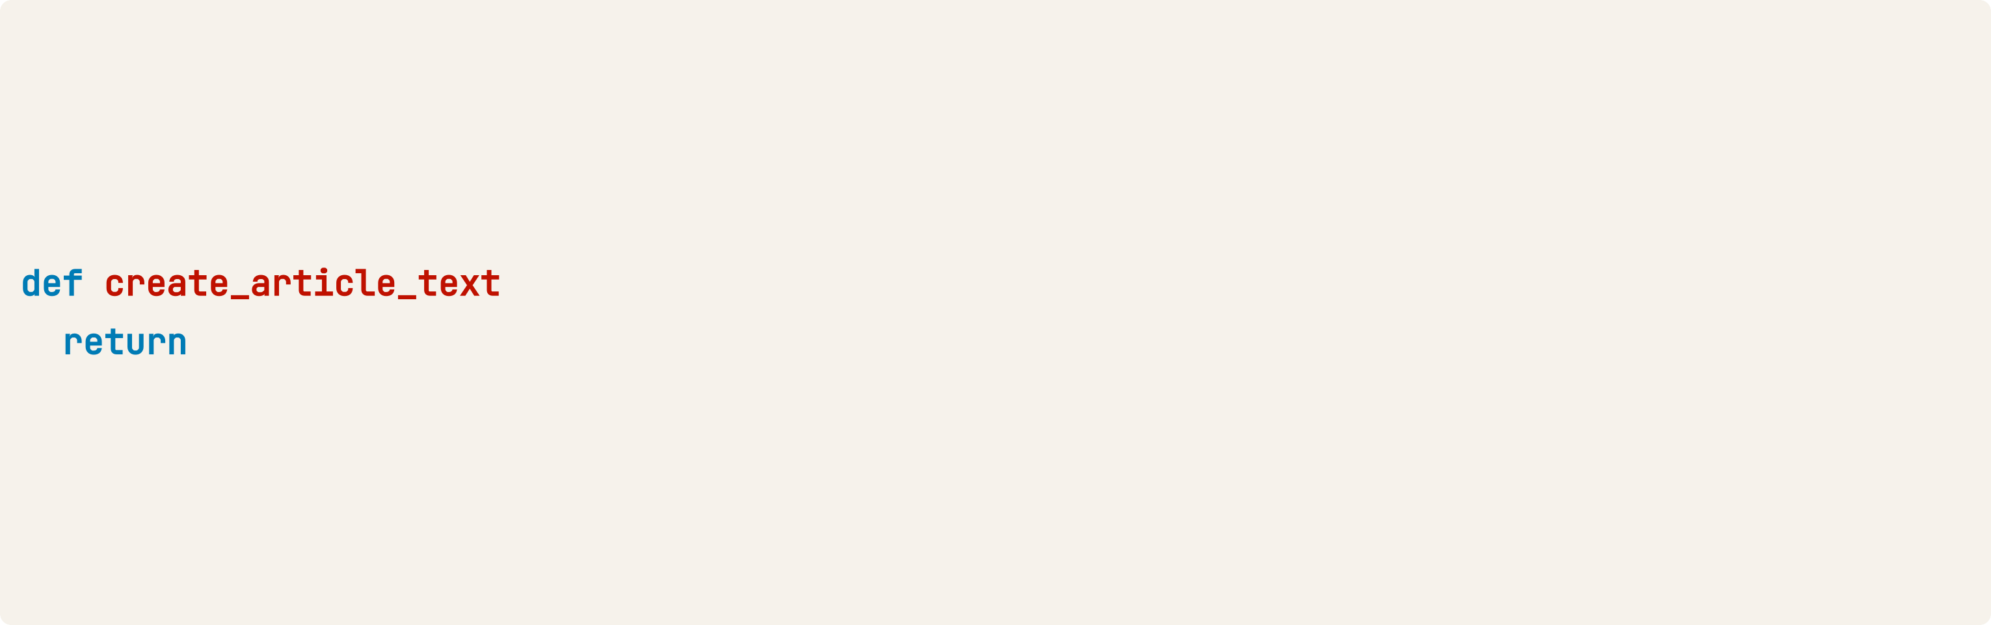
Combining features with F-strings
articles = [..., {"headline": "1.5 Billion Tune-in to the World Cup ", "topic": "Sport",
"keywords": ["soccer", "world cup", "tv"]}]
(article):
f"""Headline:
{article['headline']}
Topic:
{article['topic']}
Keywords: {', '.join(article['keywords'])}"""
print(create_article_text(articles[-1]))
Headline: 1.5 Billion Tune-in to the World Cup Final Topic: Sport
Keywords: soccer, world cup, tv

Slide 34
Creating enriched embeddings
article_texts = [create_article_text(article) article
article_embeddings = create_embeddings(article_texts) print(article_embeddings)
articles]
[[-0.019609929993748665, -0.03331860154867172, ...],
...,
[..., -0.014373429119586945, -0.005235843360424042]]

Slide 35
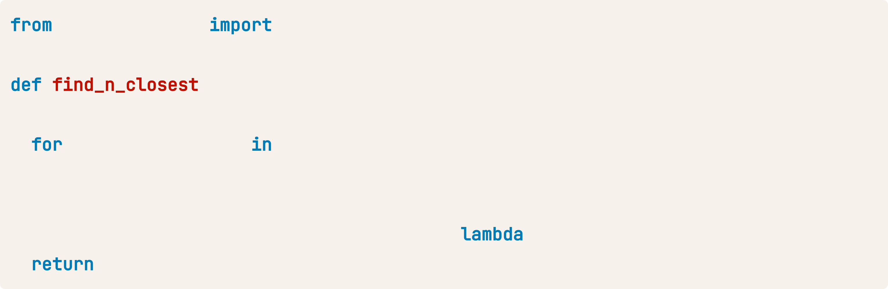
Computing distances
scipy.spatial distance
(query_vector, embeddings, n=3):
distances = []
index, embedding enumerate(embeddings): dist = distance.cosine(query_vector, embedding)
distances.append({"distance": dist, "index": index}) distances_sorted = sorted(distances, key= x: x["distance"])
distances_sorted[0:n]

Slide 36
Returning the search results
query_text = "AI"
query_vector = create_embeddings(query_text)[0]
hits = find_n_closest(query_vector, article_embeddings) hit hits:
article = articles[hit['index']] print(article['headline'])
Tech Giant Buys 49% Stake In AI Startup
Tech Company Launches Innovative Product to Improve Online Accessibility India Successfully Lands Near Moon's South Pole

Slide 37
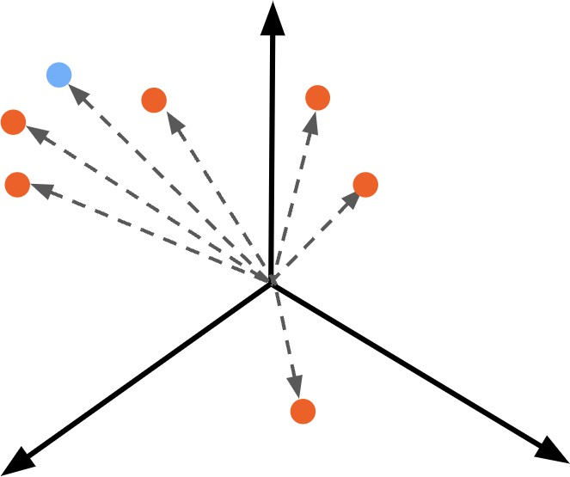
Recommendation systems with embeddings
Very similar to semantic search!
Process:
1. Embed the potential recommendations and data point

Slide 38
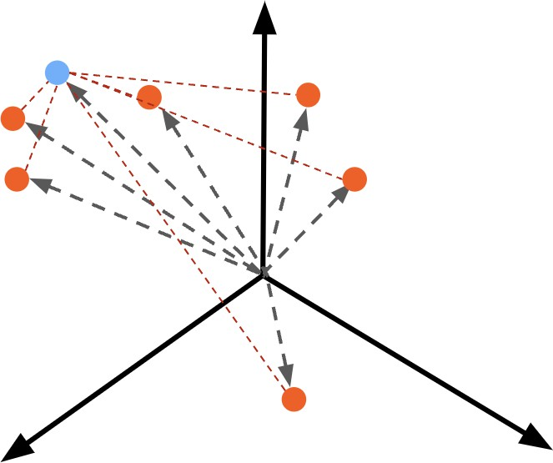
Recommendation systems with embeddings
Very similar to semantic search!
Process:
Embed the potential recommendations and data point
Calculate cosine distances

Slide 39
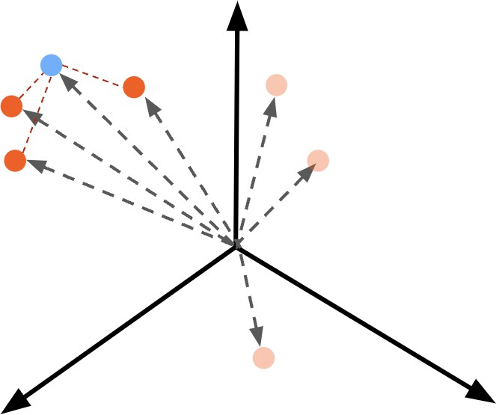
Recommendation systems with embeddings
Very similar to semantic search!
Process:
Embed the potential recommendations and data point
Calculate cosine distances
Recommend closest items

Slide 40
Example: Recommended articles
articles = [
{"headline": "Economic Growth Continues Amid Global Uncertainty", "topic": "Business",
"keywords": ["economy", "business", "finance"]},
...
{"headline": "1.5 Billion Tune-in to the World Cup Final", "topic": "Sport",
"keywords": ["soccer", "world cup", "tv"]}
]
current_article = {"headline": "How NVIDIA GPUs Could Decide Who Wins the AI Race", "topic": "Tech",
"keywords": ["ai", "business", "computers"]}

Slide 41
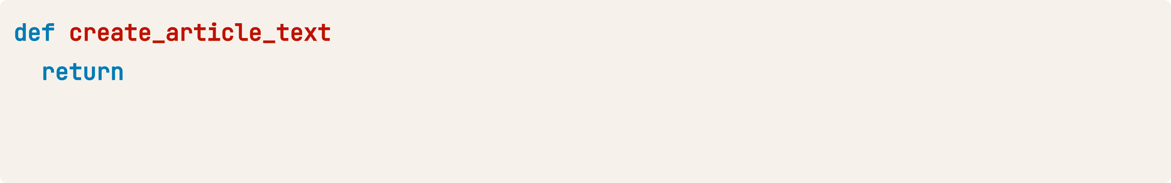
Combining features
(article):
f"""Headline:
{article['headline']}
Topic:
{article['topic']}
Keywords: {', '.join(article['keywords'])}"""
article_texts = [create_article_text(article) article current_article_text = create_article_text(current_article) print(current_article_text)
articles]
Headline: How NVIDIA GPUs Could Decide Who Wins the AI Race Topic: Tech
Keywords: ai, business, computers

Slide 42
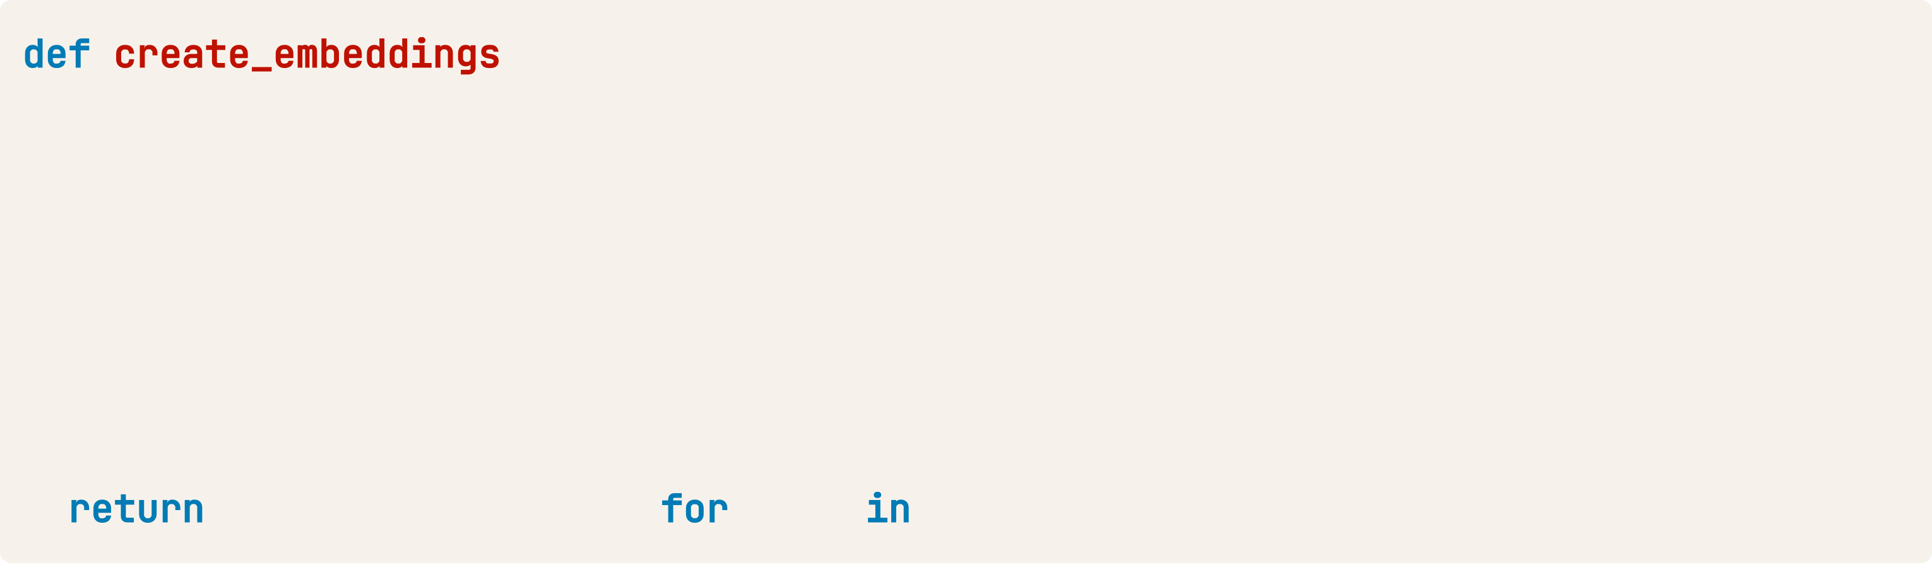
Creating Embeddings
(texts): response = openai.Embedding.create(
model="text-embedding-3-small", input=texts
)
response_dict = response.model_dump()
[data['embedding']
data
response_dict['data']]
current_article_embeddings = create_embeddings(current_article_text)[0] article_embeddings = create_embeddings(article_texts)

Slide 43
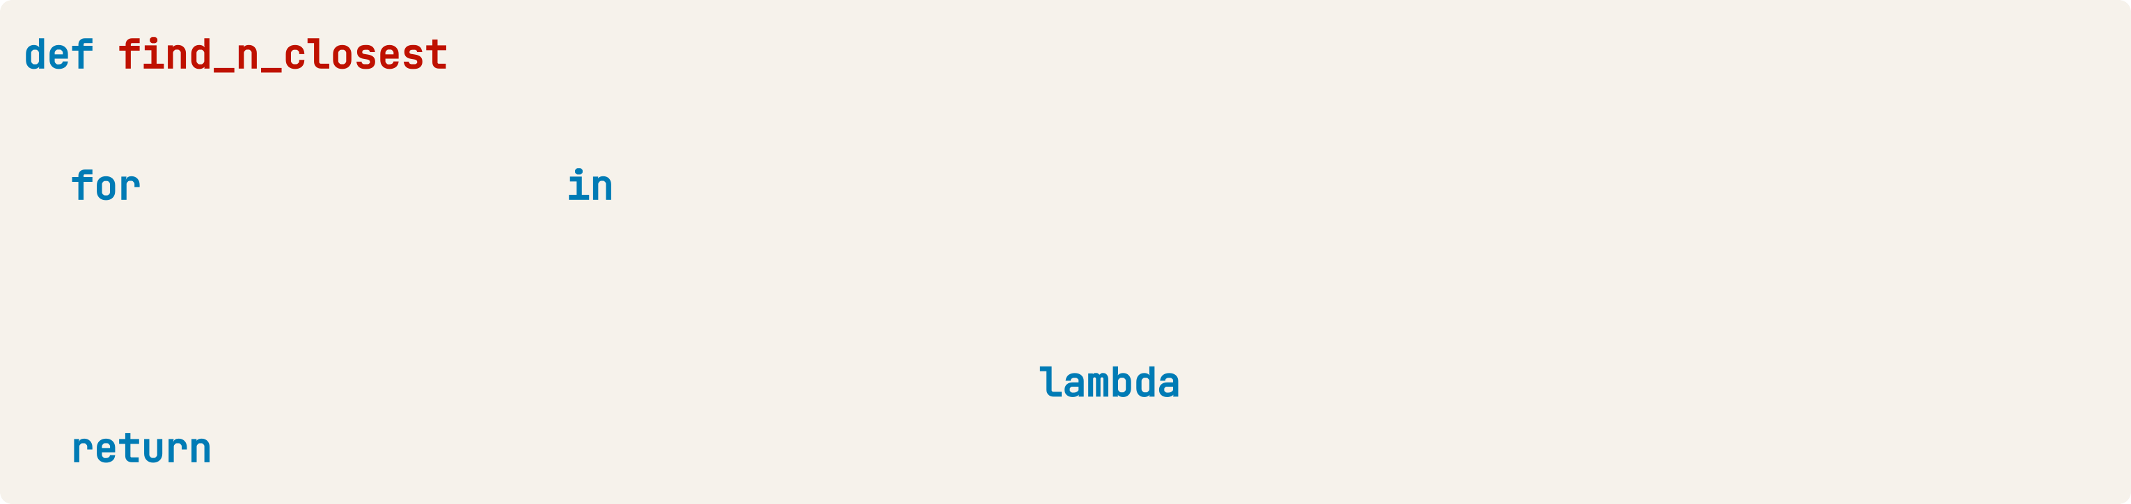
Finding the most similar article
(query_vector, embeddings, n=3):
distances = []
index, embedding enumerate(embeddings):
dist = spatial.distance.cosine(query_vector, embedding) distances.append({"distance": dist, "index": index})
distances_sorted = sorted(distances, key= x: x["distance"]) distances_sorted[0:n]
hits = find_n_closest(current_article_embeddings, article_embeddings) hit hits:
article = articles[hit['index']] print(article['headline'])

Slide 44
Finding the most similar article
Tech Giant Buys 49% Stake In AI Startup
Tech Company Launches Innovative Product to Improve Online Accessibility Scientists Make Breakthrough Discovery in Renewable Energy

Slide 45
Adding user history
user_history = [
{"headline": "How NVIDIA GPUs Could Decide Who Wins the AI Race", "topic": "Tech",
"keywords": ["ai", "business", "computers"]},
{"headline": "Tech Giant Buys 49% Stake In AI Startup", "topic": "Tech",
"keywords": ["business", "AI"]}
]

Slide 46
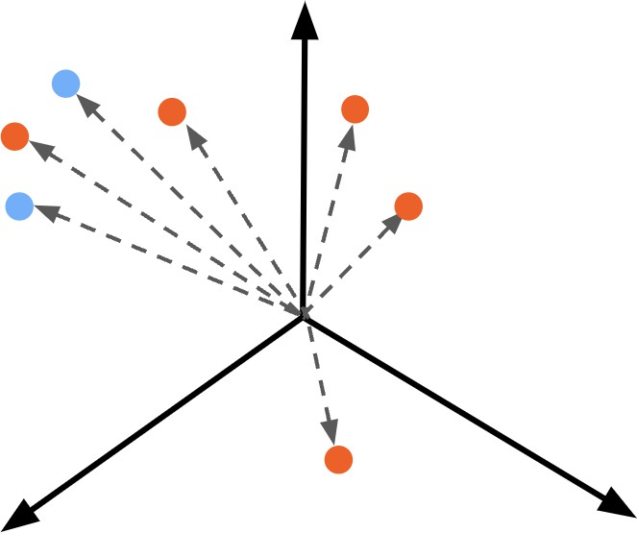
Recommendations on multiple data points

Slide 47
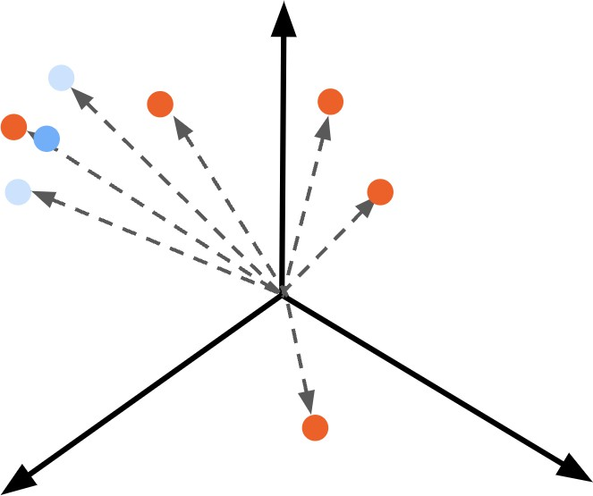
Recommendations on multiple data points
Process:
Combine multiple vectors into one by taking the mean
Compute cosine distances

Slide 48
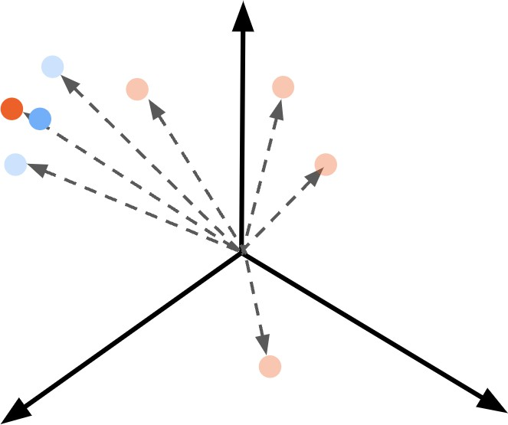
Recommendations on multiple data points
Process:
Combine multiple vectors into one by taking the mean
Compute cosine distances Recommend closest vector

Slide 49
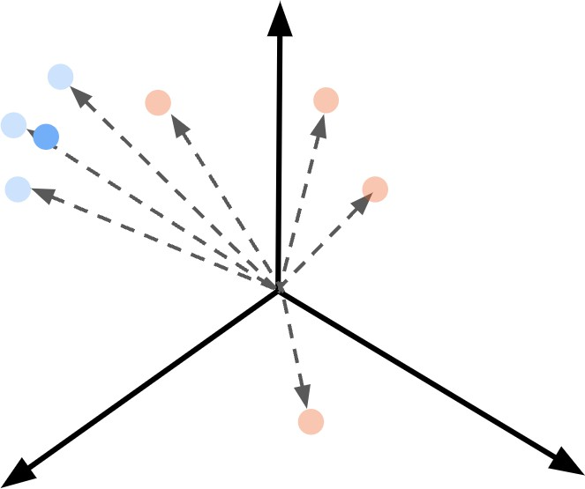
Recommendations on multiple data points
Process:
Combine multiple vectors into one by taking the mean
Compute cosine distances Recommend closest vector

Slide 50
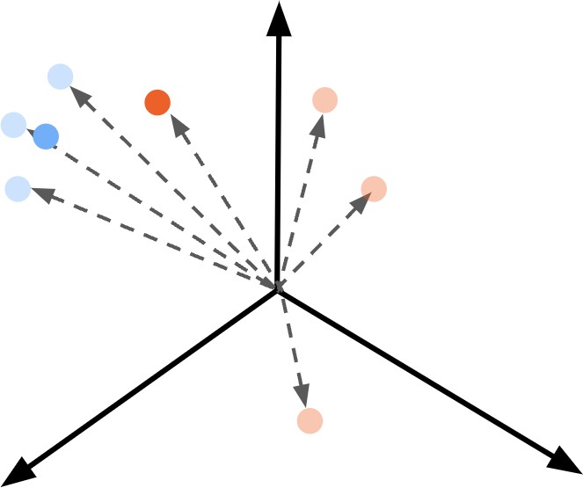
Recommendations on multiple data points
Process:
Combine multiple vectors into one by taking the mean
Compute cosine distances
Recommend closest vector Ensure that it's unread

Slide 51
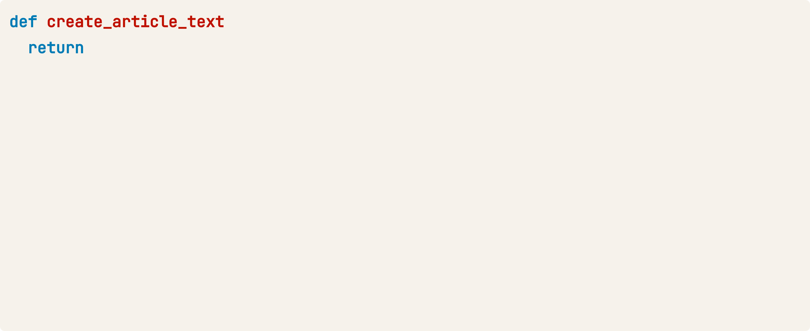
Recommendations on multiple data points
(article):
f"""Headline:
{article['headline']}
Topic:
{article['topic']}
Keywords: {', '.join(article['keywords'])}"""
history_texts = [create_article_text(article) article user_history] history_embeddings = create_embeddings(history_texts) mean_history_embeddings = np.mean(history_embeddings, axis=0)
articles_filtered = [article article articles
article user_history]
article_texts = [create_article_text(article) article articles_filtered] article_embeddings = create_embeddings(article_texts)

Slide 52
Recommendations on multiple data points
hits = find_n_closest(mean_history_embeddings, article_embeddings)
hit hits:
article = articles_filtered[hit['index']] print(article['headline'])
Tech Company Launches Innovative Product to Improve Online Accessibility New Social Media Platform Has Everyone Talking!
Scientists Make Breakthrough Discovery in Renewable Energy

Slide 53
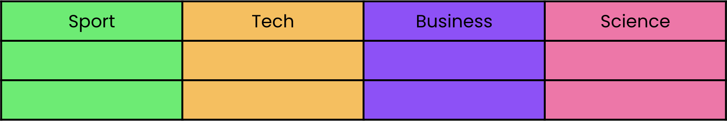
Classification tasks
Assigning labels to items
Categorization
Example: headlines into topics
Sentiment analysis

Slide 54
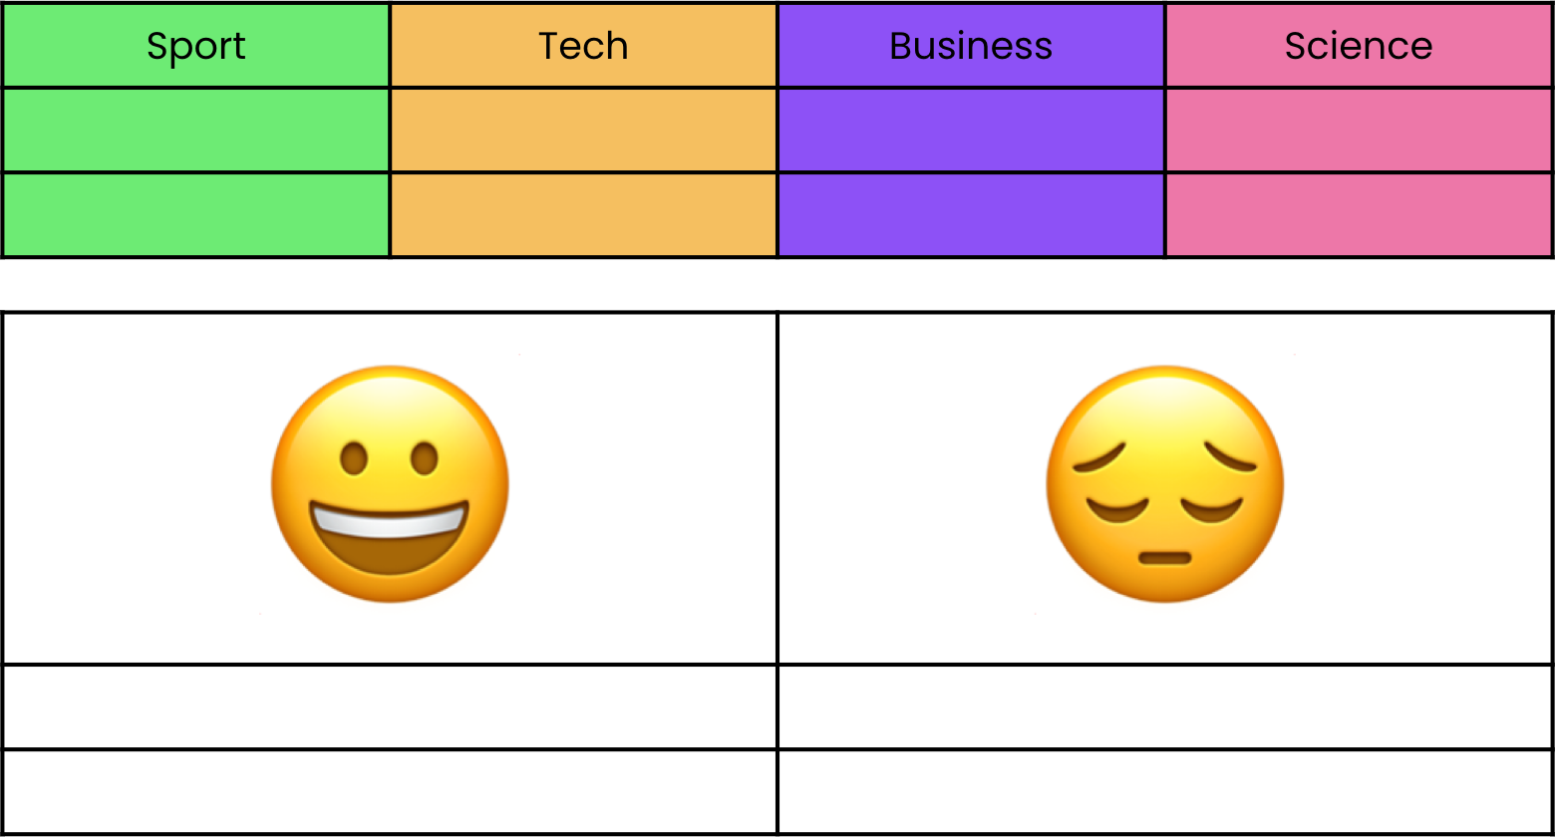
Classification tasks
Assigning labels to items
Categorization
Example: headlines into topics
Sentiment analysis
Example: Classifying reviews as positive or negative
Embeddings capture semantic meaning

Slide 55
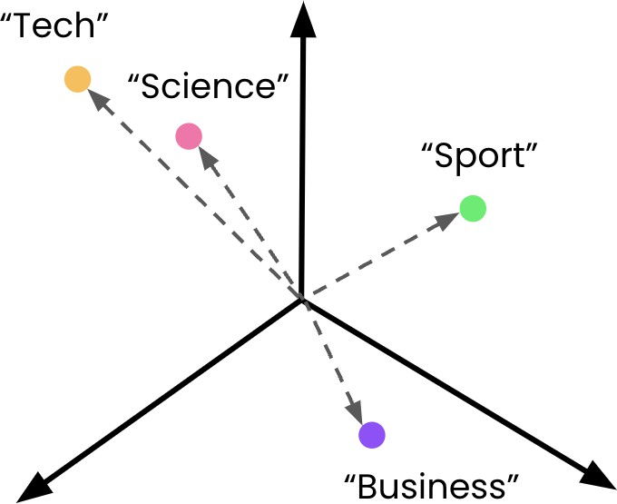
Classification with embeddings
Zero-shot classification: Not using labeled data
Process:
1. Embed class descriptions

Slide 56
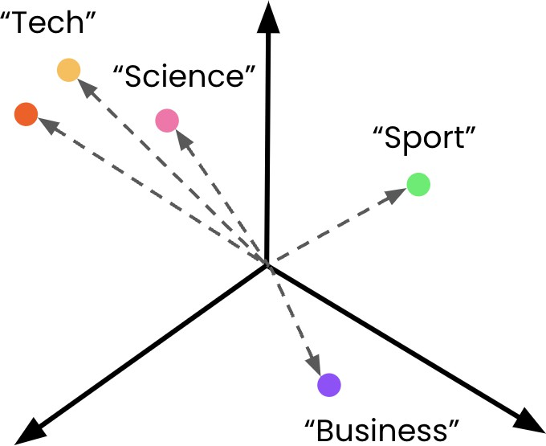
Classification with embeddings
Zero-shot classification: Not using labeled data
Process:
Embed class descriptions
Embed the item to classify
Compute cosine distances

Slide 57
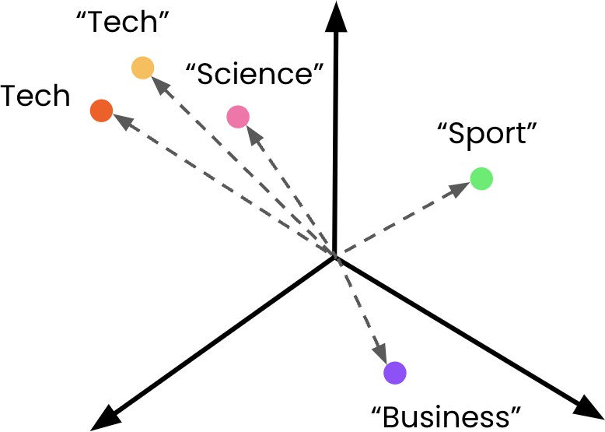
Classification with embeddings
Zero-shot classification: Not using labeled data
Process:
Embed class descriptions
Embed the item to classify
Compute cosine distances
Assign the most similar label

Slide 58
Embedding class descriptions
topics = [
{'label': 'Tech'},
{'label': 'Science'},
{'label': 'Sport'},
{'label': 'Business'},
]
class_descriptions = [topic['label'] topic topics] class_embeddings = create_embeddings(class_descriptions)

Slide 59
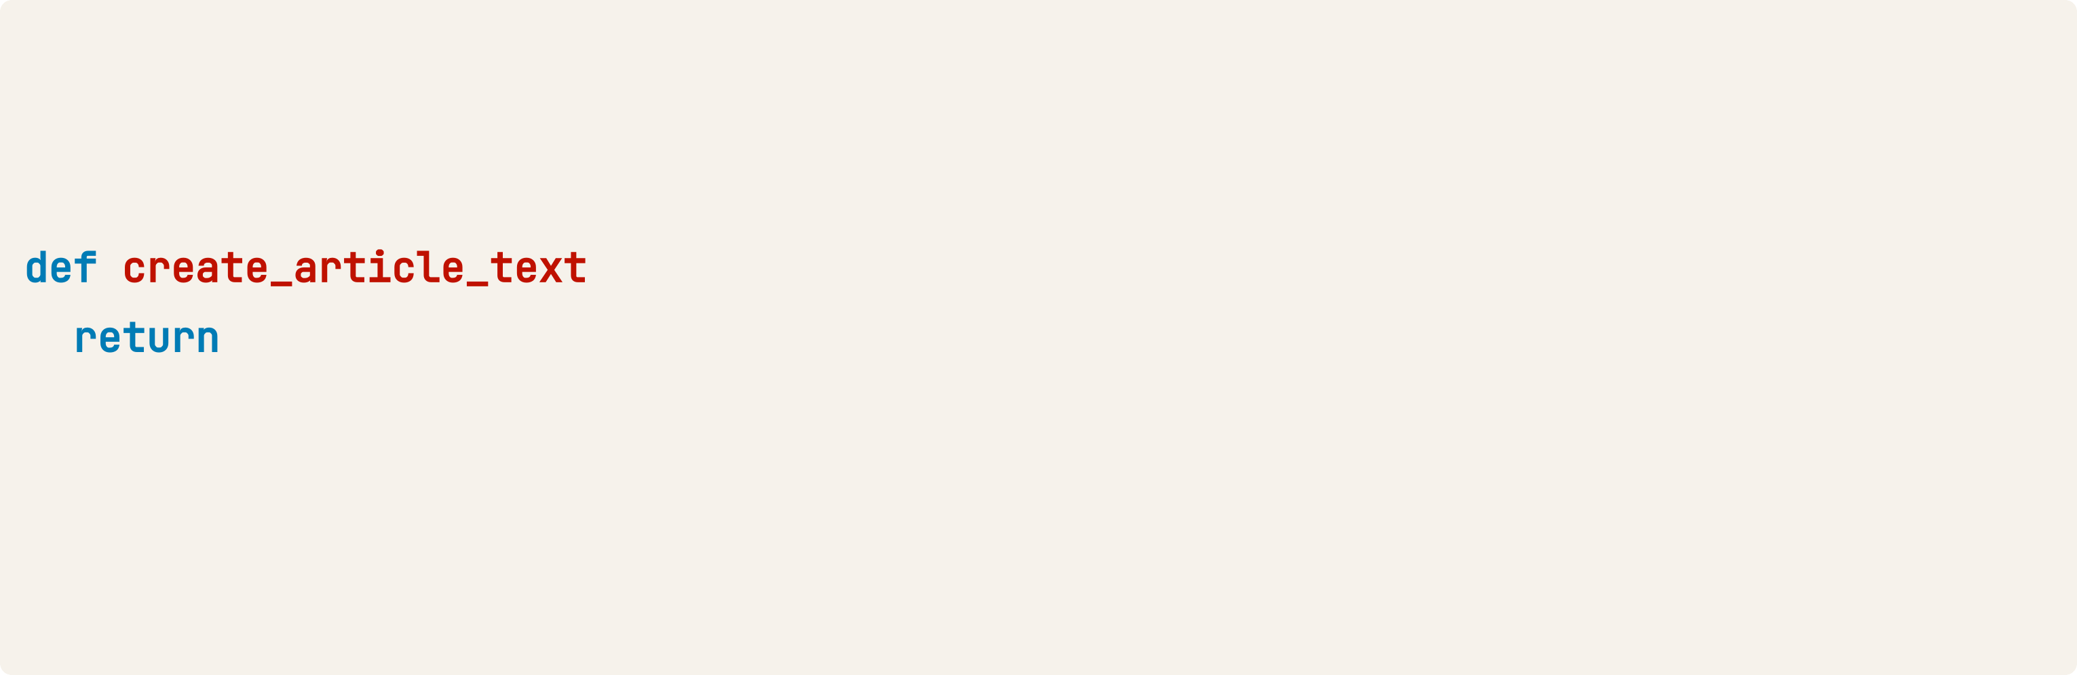
Embedding item to classify
article = {"headline": "How NVIDIA GPUs Could Decide Who Wins the AI Race", "keywords": ["ai", "business", "computers"]}
(article): f"""Headline: {article['headline']}
Keywords: {', '.join(article['keywords'])}"""
article_text = create_article_text(article) article_embeddings = create_embeddings(article_text)[0]

Slide 60
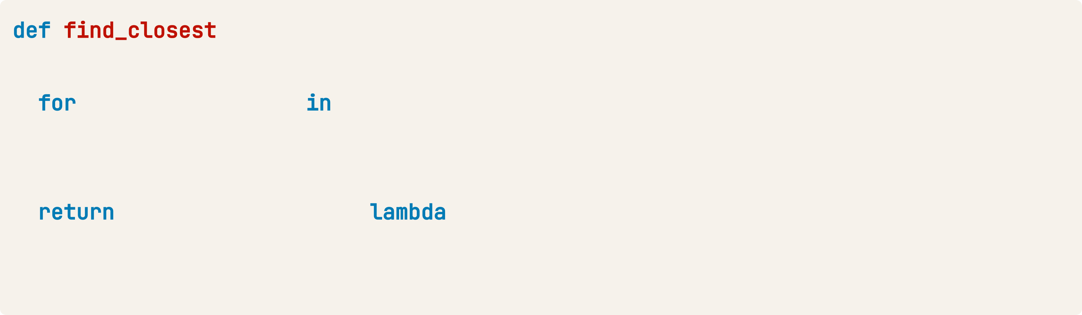
Compute cosine distances
(query_vector, embeddings): distances = []
index, embedding enumerate(embeddings): dist = distance.cosine(query_vector, embedding)
distances.append({"distance": dist, "index": index}) min(distances, key= x: x["distance"])
closest = find_closest(article_embeddings, class_embeddings)

Slide 61
Extract the most similar label
label = topics[closest['index']]['label'] print(label)
Business
article = {"headline": "How NVIDIA GPUs Could Decide Who Wins the AI Race", "keywords": ["ai", "business", "computers"]}
Limitation:
Class descriptions lacked sufficient detail

Slide 62
More detailed descriptions
topics = [
{'label': 'Tech', 'description': 'A news article about technology'},
{'label': 'Science', 'description': 'A news article about science'},
{'label': 'Sport', 'description': 'A news article about sports'},
{'label': 'Business', 'description': 'A news article about business'},
]
class_descriptions = [topic['description'] topic topics] class_embeddings = create_embeddings(class_descriptions)
[...]
label = topics[closest['index']]['label'] print(label)
Tech

Slide 63
Vector databases for embedding systems

Slide 64
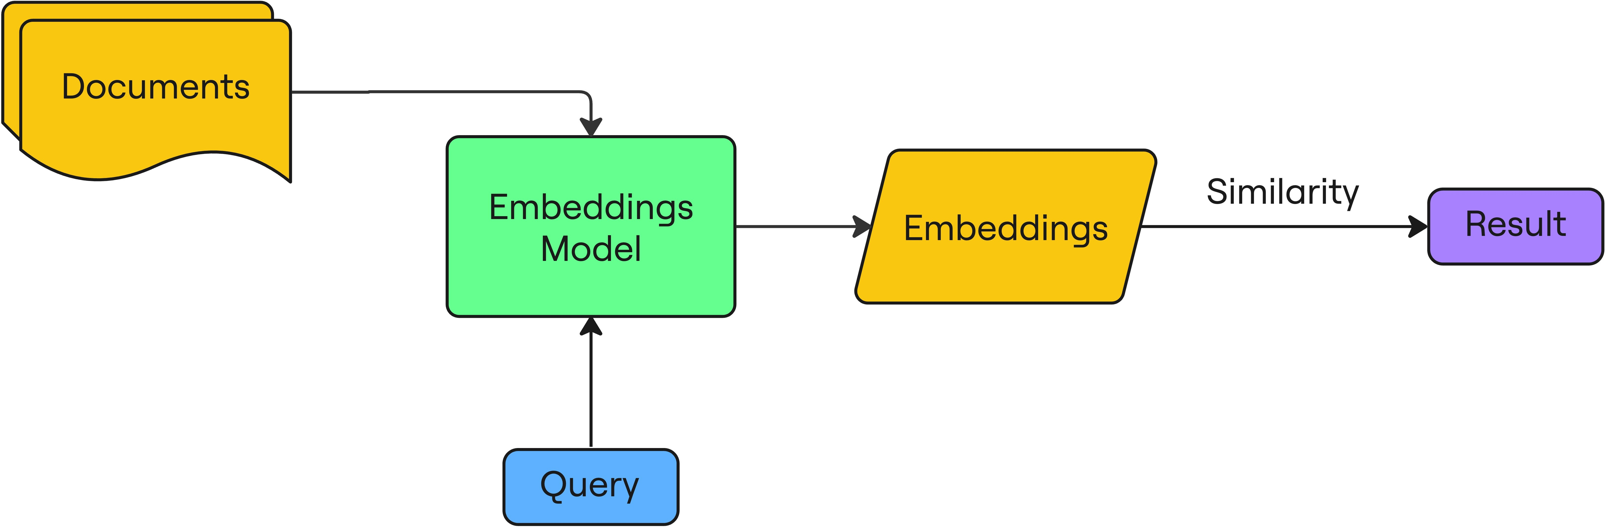
Limitations of the current approach
Loading all the embeddings into memory (1536 floats ~ 13kB/embedding)
Recalculated embeddings for each new query
Calculating cosine distances for every embedding and sorting is slow and scales linearly

Slide 65
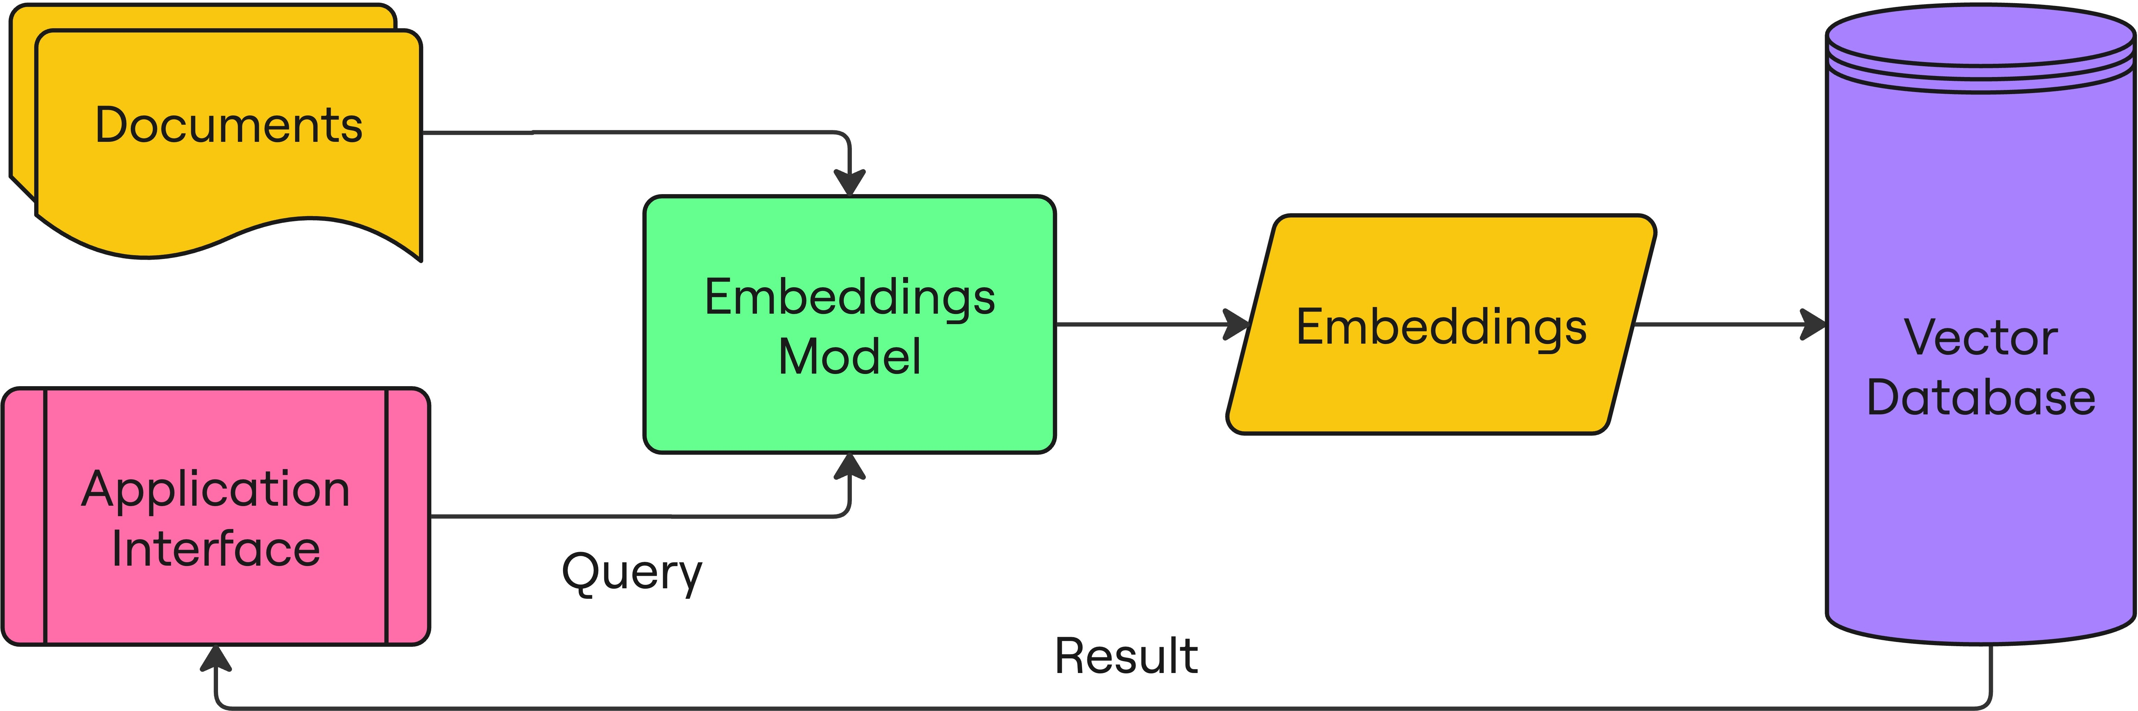
Vector databases
Embedded documents are stored and queried from the vector database

Slide 66
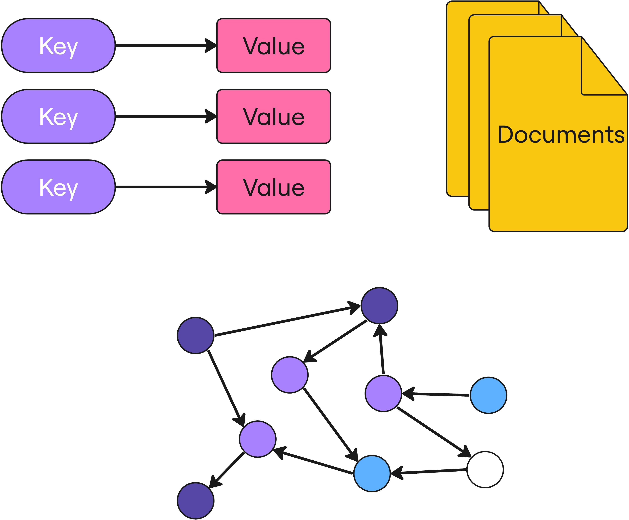
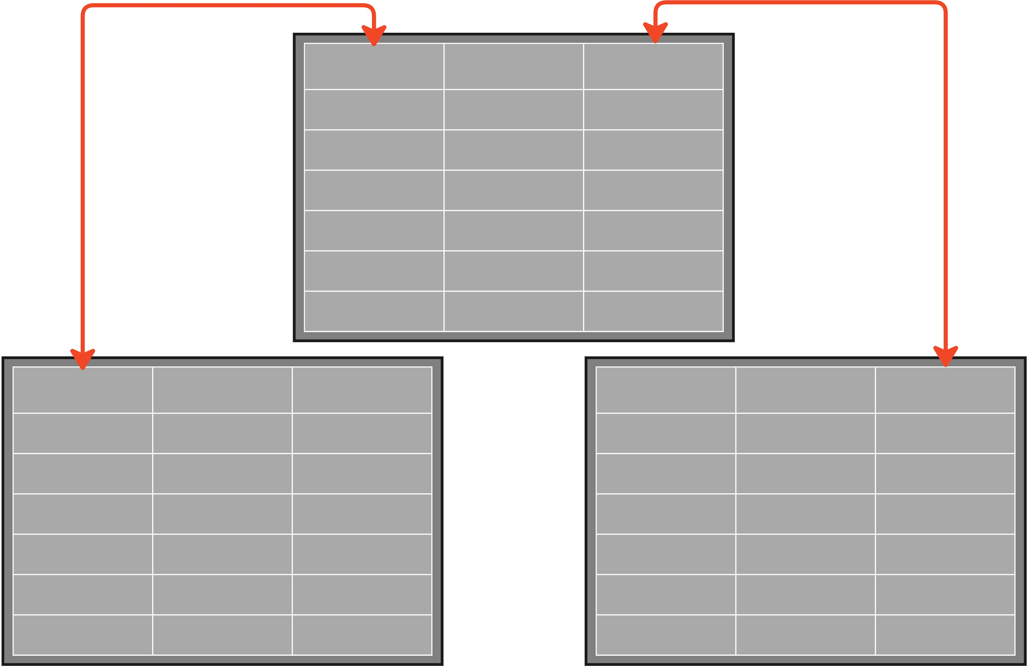
NoSQL Database
More flexible structure that allows for faster
querying

Slide 67
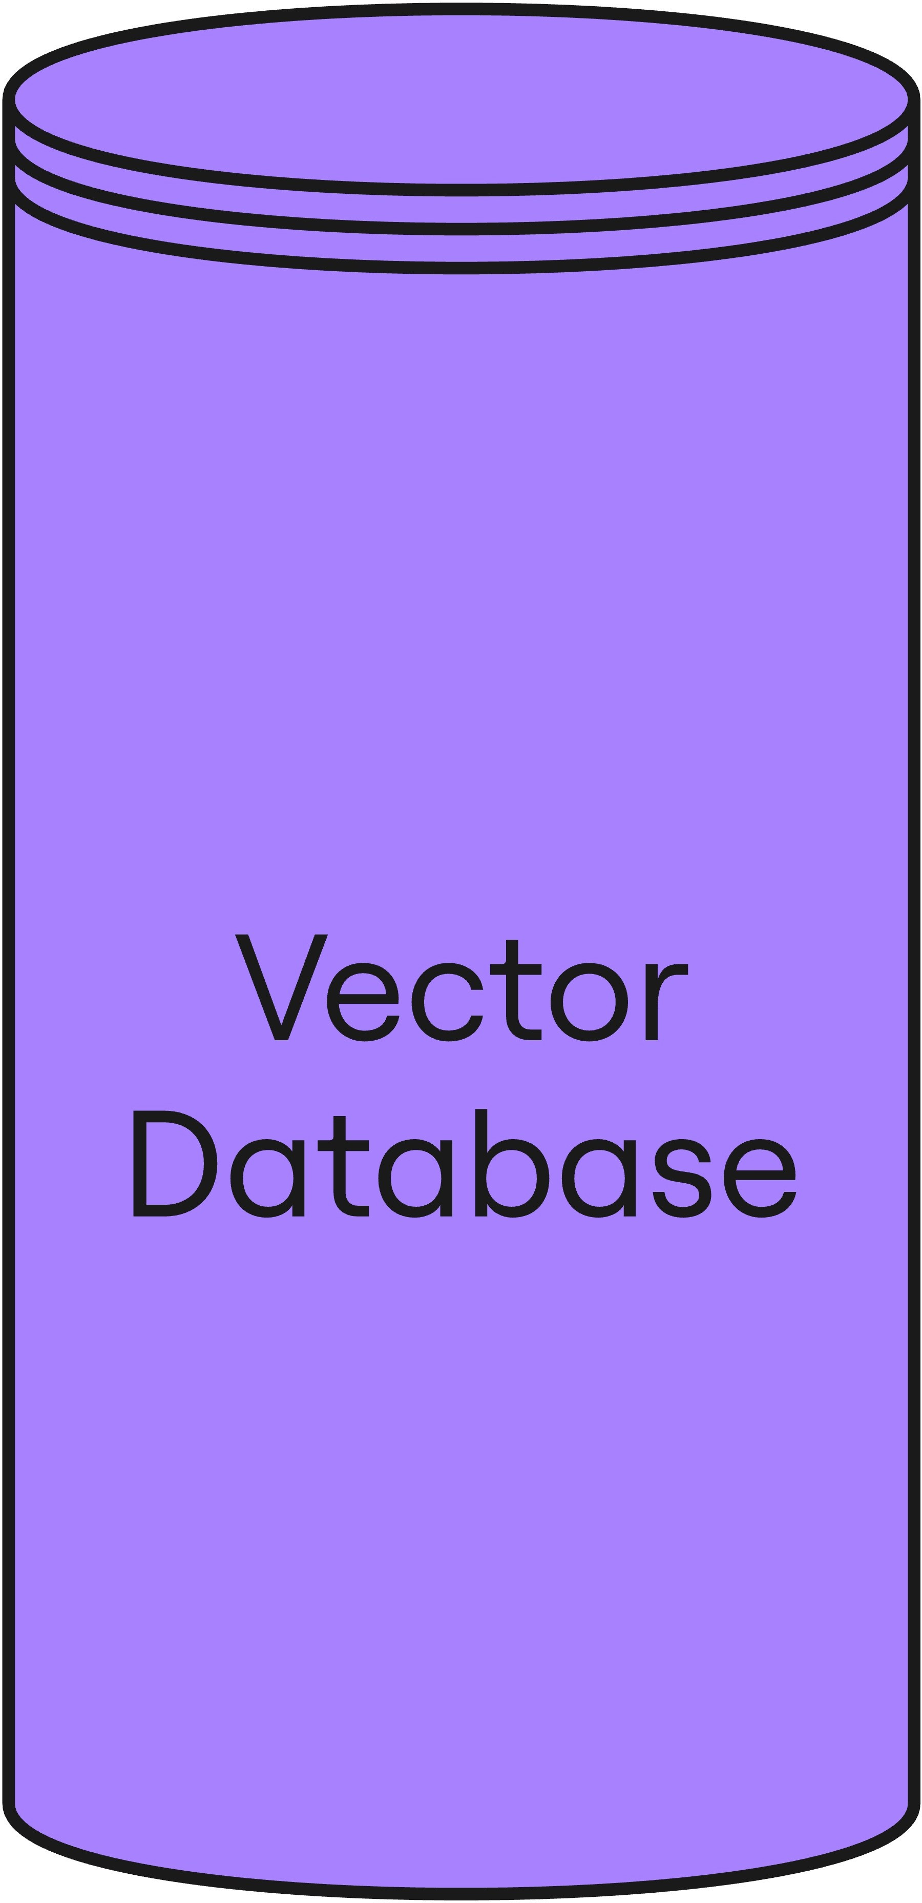
Components to store
Embeddings
Source texts Metadata
IDs and references
Additional data useful for filtering results
Top tip: Don't store the source text as metadata!

Slide 68
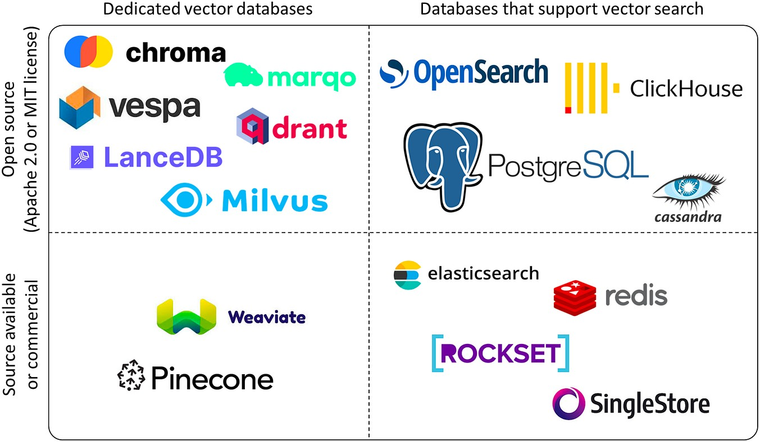
The vector database landscape

Slide 69

Which solution is best?
Database management:
Managed → more expensive but lowers workload
Self-managed → cheaper but requires time and expertise
Open source or commercial?
Open source → flexible and cost- effective
Commercial → better support, more advanced features, and compliance
Data models: does the type of data lend itself to a particular database type?
Specific features: does your use case depend on specific functionality, such as multi-modal storage?

Slide 70
Creating vector databases with ChromaDB

Slide 71
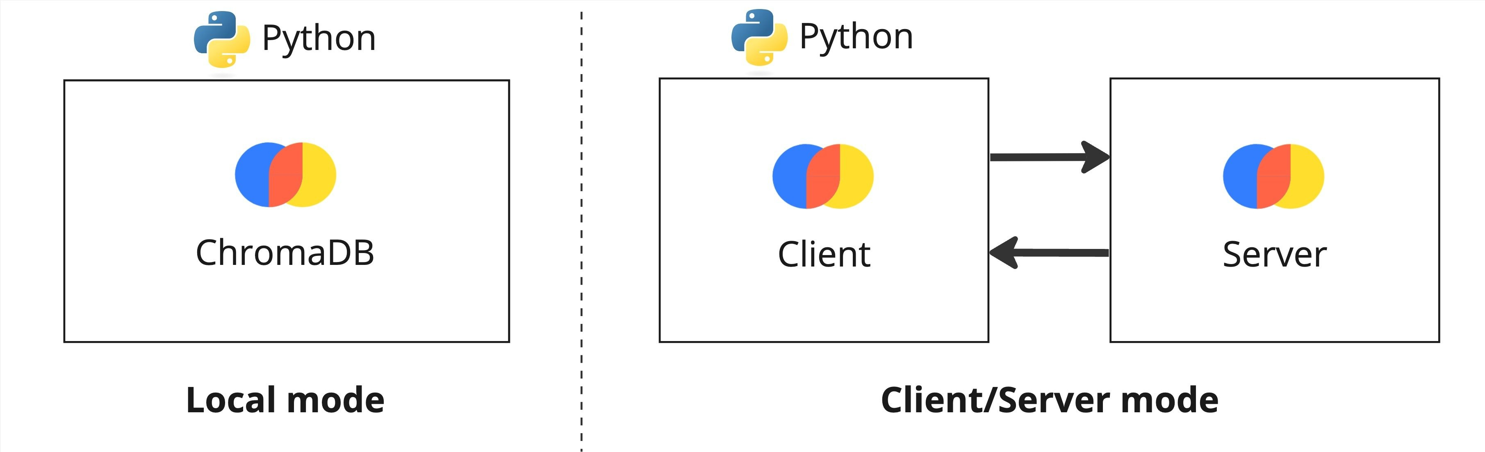
Installing ChromaDB
ChromaDB is a simple yet powerful vector database
Two flavors:
Local: great for development and prototyping
Client/Server: made for production

Slide 72
Connecting to the database
import chromadb
client = chromadb.PersistentClient(path="/path/to/save/to")
Data will be persisted to disk

Slide 73
Creating a collection
Collections are analogous to tables
from chromadb.utils.embedding_functions import OpenAIEmbeddingFunction
collection = client.create_collection( name="my_collection", embedding_function=OpenAIEmbeddingFunction(
model_name="text-embedding-3-small", api_key="..."
)
)
Collections are able to create embeddings automatically

Slide 74
Inspecting collections
client.list_collections()
[Collection(name=my_collection)]

Slide 75
Inserting embeddings
Single document
collection.add(ids=["my-doc"], documents=["This is the source text"])
IDs must be provided
Embeddings will be created by the collection!
Multiple documents
collection.add(
ids=["my-doc-1", "my-doc-2"],
documents=["This is document 1", "This is document 2"]
)

Slide 76
Inspecting a collection
Counting documents in a collection
collection.count()
3

Slide 77
Inspecting a collection
Peeking at the first 10 items
collection.peek()
{'ids': ['my-doc', 'my-doc-1', 'my-doc-2'],
'embeddings': [[...], [...], [...]], 'documents': ['This is the source text',
'This is document 1', 'This is document 2'],
'metadatas': [None, None, None]}

Slide 78
Retrieving items
collection.get(ids=["s59"])
{'ids': ['s59'],
'embeddings': None, 'metadatas': [None],
'documents': ['Title: Naruto Shippûden the Movie: The Will of Fire (Movie)\nDescription: When ...'], 'uris': None,
'data': None}

Slide 79
Netflix dataset
Title: Kota Factory (TV Show)
Description: In a city of coaching centers known to train India's finest... Categories: International TV Shows, Romantic TV Shows, TV Comedies
Title: The Last Letter From Your Lover (Movie)
Description: After finding a trove of love letters from 1965, a reporter sets... Categories: Dramas, Romantic Movies

Slide 80
Estimating embedding cost
Embedding model ( text-embedding-3-small ) costs $0.00002/1k tokens
cost = 0.00002 * len(tokens)/1000
Count tokens with the tiktoken library
pip install tiktoken

Slide 81
Estimating embedding cost
import tiktoken
enc = tiktoken.encoding_for_model("text-embedding-3-small") total_tokens = sum(len(enc.encode(text)) for text in documents) cost_per_1k_tokens = 0.00002
print('Total tokens:', total_tokens)
print('Cost:', cost_per_1k_tokens * total_tokens/1000)
Total tokens: 444463
Cost: 0.00888926

Slide 82
Querying and updating the database

Slide 83
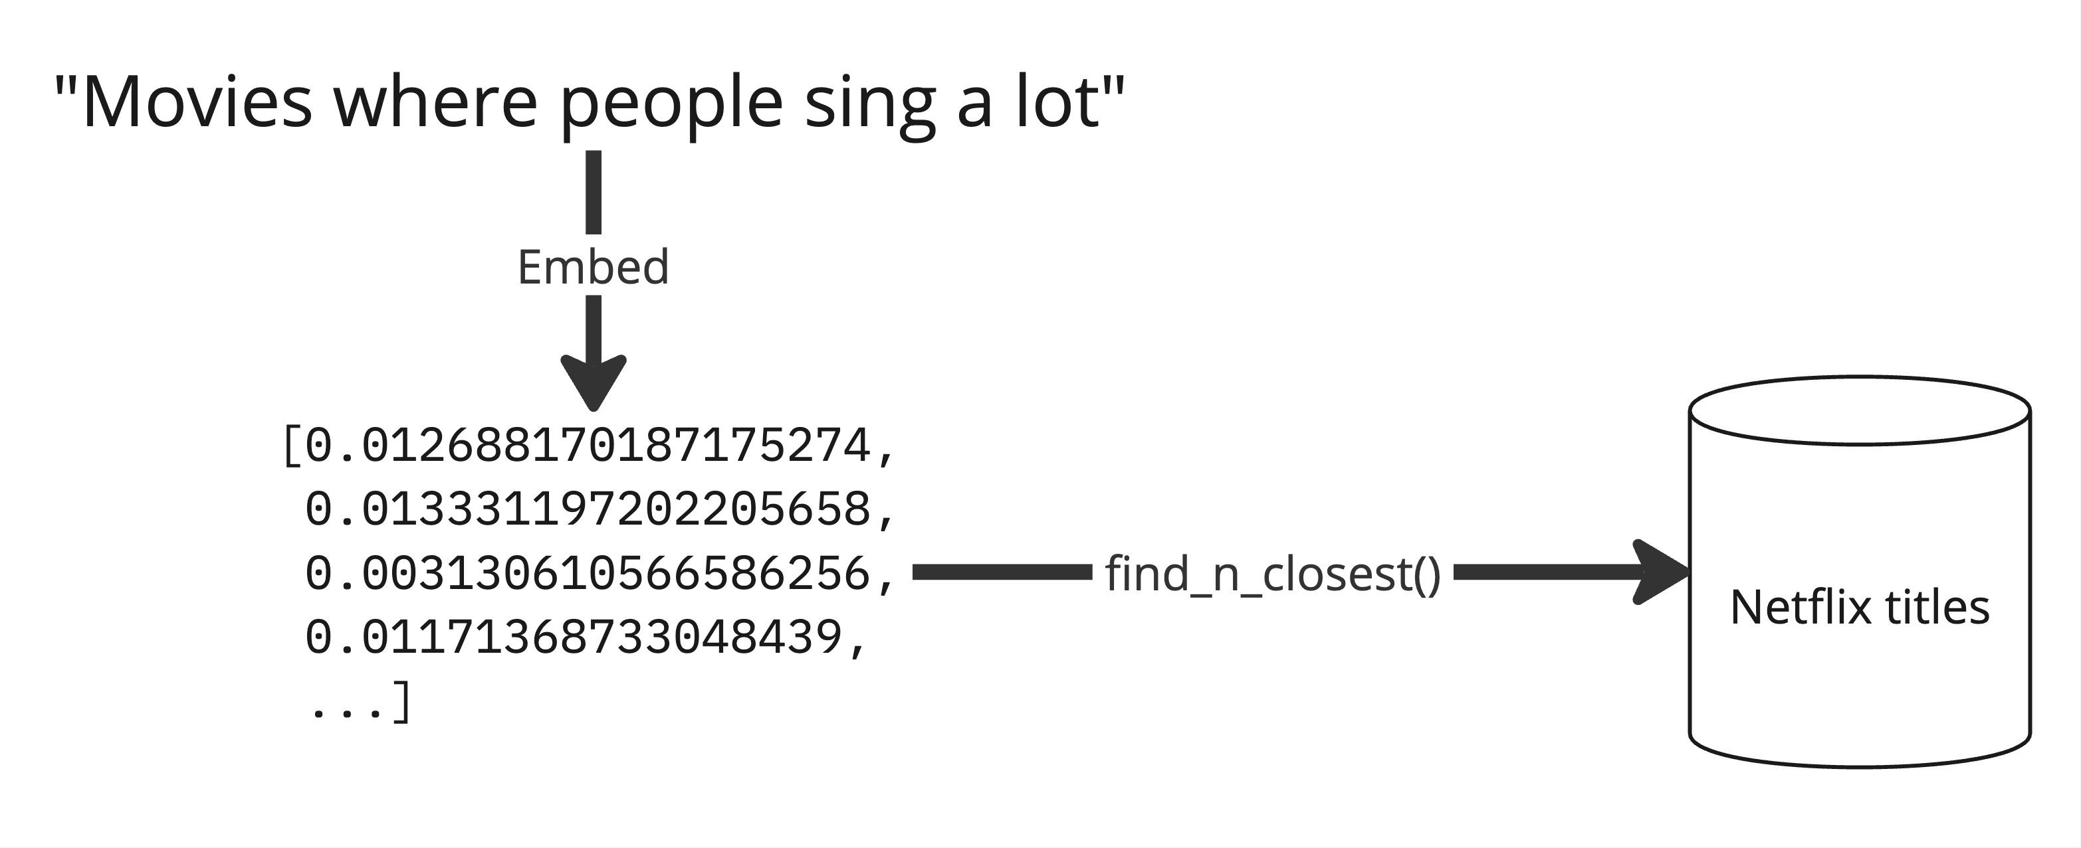
Querying the database

Slide 84
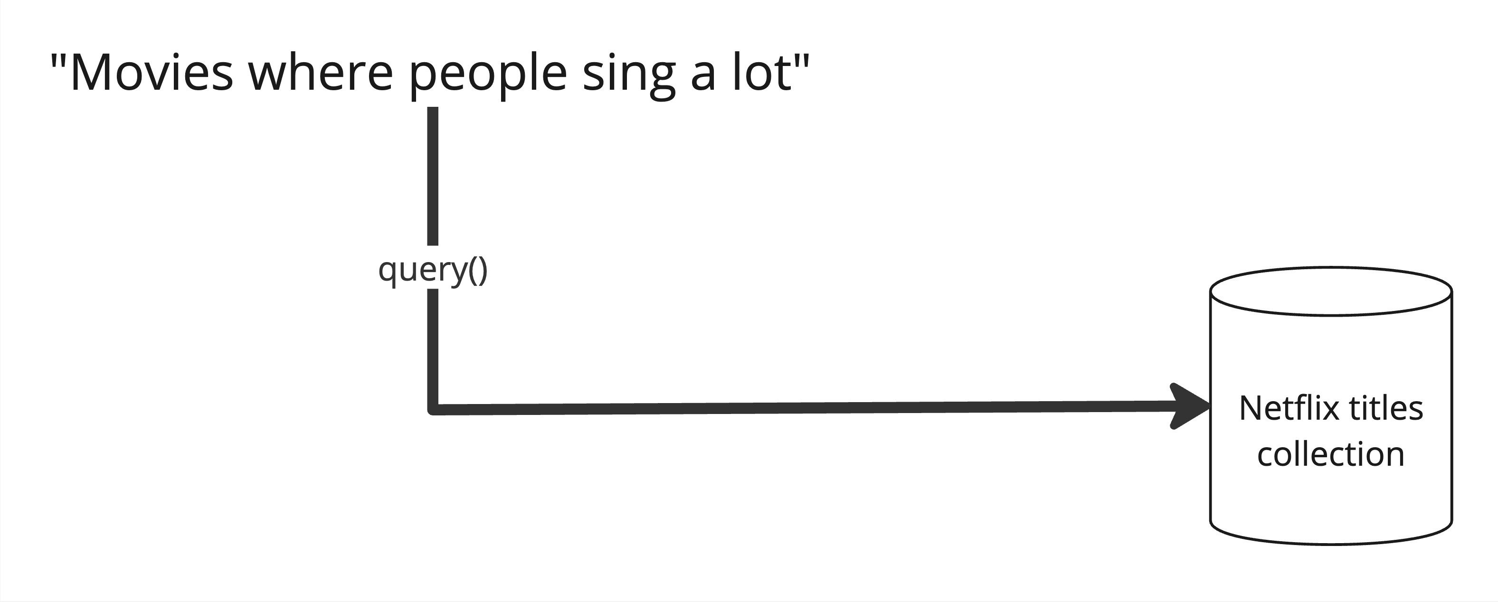
Querying the database

Slide 85
Retrieve the collection
from chromadb.utils.embedding_functions import OpenAIEmbeddingFunction
collection = client.get_collection( name="netflix_titles",
embedding_function=OpenAIEmbeddingFunction(api_key="...")
)
Must be specify the same embedding function used when adding data to the collection

Slide 86
Querying the collection
result = collection.query(
query_texts=["movies where people sing a lot"], n_results=3
)
print(result)
{'ids': [['s4068', 's293', 's2213']],
'embeddings': None,
'documents': [['Title: Quién te cantará (Movie)\nDescription: When a near-...', 'Title: Quartet (Movie)\nDescription: To save their posh retirement home, ...', 'Title: Sing On! Spain (TV Show)\nDescription: In this fast-paced, high-...']],
'metadatas': [[None, None, None]],
'distances': [[0.350419282913208, 0.36049118638038635, 0.37080681324005127]]

Slide 87
query() returns a dict with multiple keys:
ids : The ids of the returned items
embeddings : The embeddings of the returned items documents : The source texts of the returned items metadatas : The metadatas of the returned items
distances : The distances of the returned items from the query text
{'ids': [...],
'embeddings': None, 'documents': [...],
'metadatas': [...],
'distances': [...]}

Slide 88
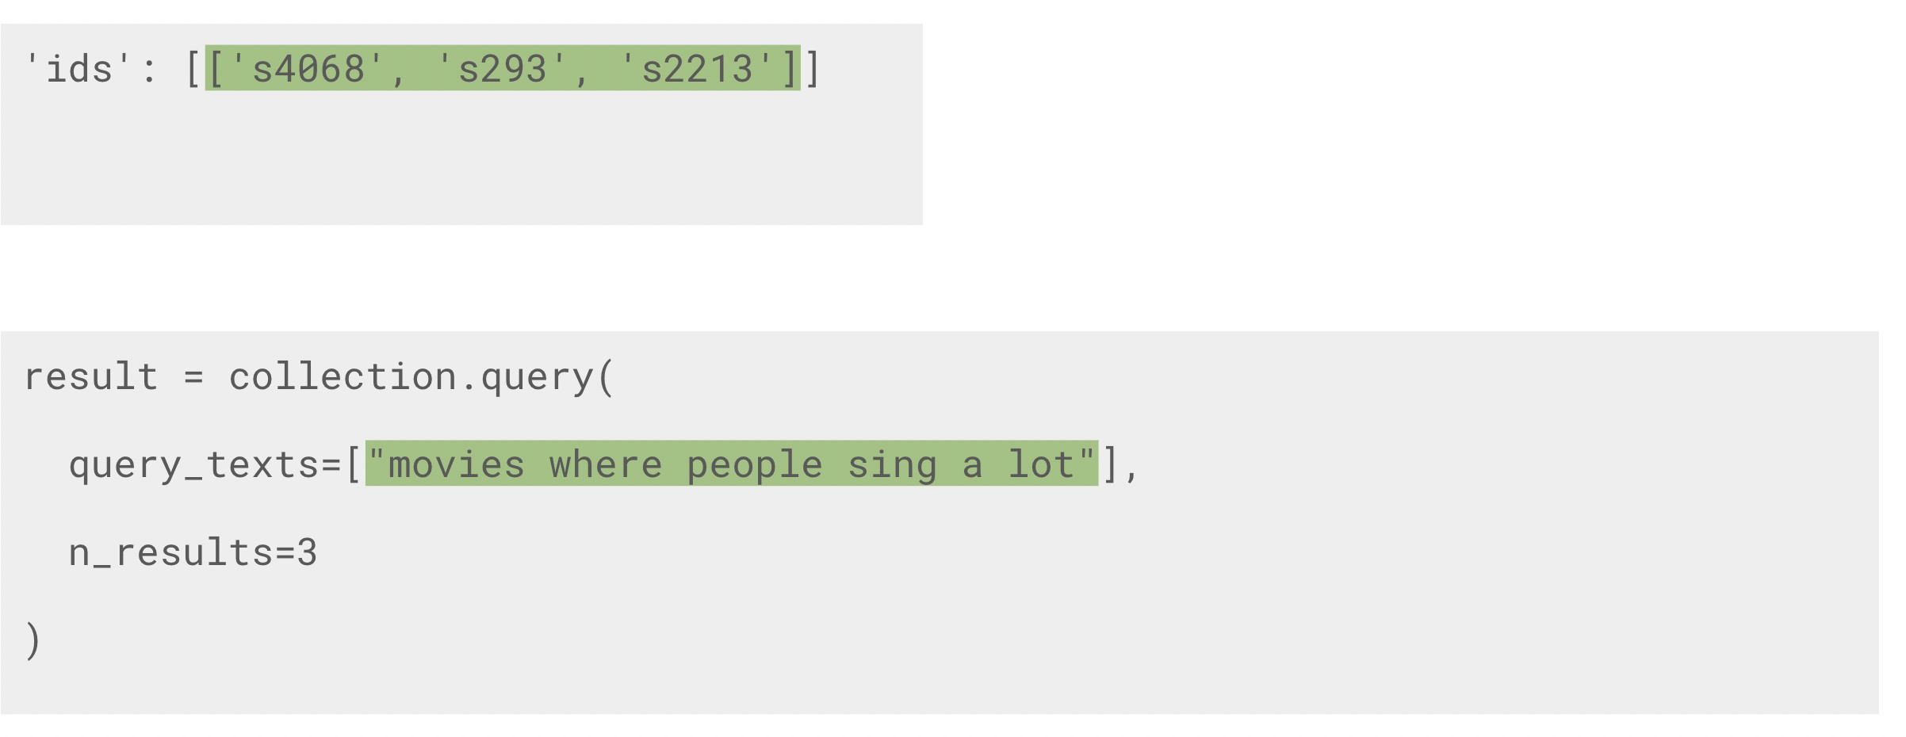
First list corresponds to the first query_text
Multiple query texts will return multiple lists

Slide 89
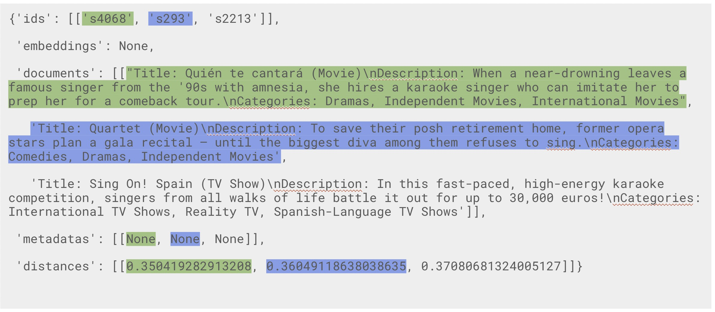

Slide 90
Updating a collection
collection.update( ids=["id-1", "id-2"],
documents=["New document 1", "New document 2"]
)
Include only the fields to update, other fields will be unchanged Collection will automatically create embeddings

Slide 91
Upserting a collection
collection.upsert( ids=["id-1", "id-2"],
documents=["New document 1", "New document 2"]
)
If IDs are missing → add them
If IDs are present → update them

Slide 92
Deleting
Delete items from a collection
collection.delete(ids=["id-1", "id-2"])
Delete all collections and items
client.reset()
Warning: this will delete everything in the database!

Slide 93
Multiple queries and filtering

Slide 94
Movie recommendations based on multiple datapoints
Terrifier (id: 's8170' )
Strawberry Shortcake: Berry Bitty Adventures (id: 's8103' )

Slide 95
Multiple query texts
reference_ids = ['s8170', 's8103']
reference_texts = collection.get(ids=reference_ids)["documents"] result = collection.query(
query_texts=reference_texts, n_results=3
)

Slide 96
Multiple query texts result
{'ids': [['s8170', 's6939', 's7000'],['s8103', 's2968', 's3085']],
'embeddings': None,
'documents': [['Title: Terrifier (Movie)...',
'Title: | Haunters: The Art of the Scare (Movie)...',
'Title: | Horror Story (Movie)...'],
["Title: | Strawberry Shortcake: Berry Bitty Adventures | (TV | Show)...",
"Title: | Shopkins (TV Show)...",
"Title: Rainbow Ruby (TV | Show)..."]],
'metadatas': [[None, None, | None], [None, | None, | None]],
'distances': [[0.00, 0.25, | 0.26], [0.00, | 0.25, | 0.28]]}

Slide 97
Adding metadata
import csv
ids = [] metadatas = []
with open('netflix_titles.csv') as csvfile: reader = csv.DictReader(csvfile)
for i, row in enumerate(reader): ids.append(row['show_id']) metadatas.append({
"type":row['type'],
"release_year": int(row['release_year']
})
Create a list of dicts for the metadatas
Create a list of IDs to add them to the existing items

Slide 98
Adding and querying metadatas
collection.update(ids=ids, metadatas=metadatas)
result = collection.query( query_texts=reference_texts, n_results=3,
where={
"type": "Movie"
}
)

Slide 99
Where operators
where={
"type": "Movie"
}
List of operators:
$eq - equal to (string, int, float)
$ne - not equal to (string, int, float)
$gt - greater than (int, float)
is the same as
where={ "type": {
"$eq": "Movie"
}
}
$gte - greater than or equal to (int, float)
$lt - less than (int, float)
$lte - less than or equal to (int, float)

Slide 100
Multiple where filters
where={
"$and": [
{"type":
{"$eq": "Movie"}
},
{"release_year":
{"$gt": 2020}
}
]
}
$or : filter based on at least one condition

Slide 101
Title: A Classic Horror Story (Movie) [...]
===
Title: === | Nightbooks (Movie) | [...]
Title: | Irul (Movie) [...]
===
Title: | Intrusion (Movie) | [...]
===
Title: Things Heard & Seen (Movie) [...]
===
Title: A StoryBots Space Adventure (Movie) [...]

Slide 102
Review 1 - What are Embeddings?
Embeddings: vector/numerical representation of text
Capture the semantic meaning of text Used OpenAI's Embedding model
Can use the cosine distance to find similar texts
Unlocks semantic search, recommendation engines, etc.

Slide 103

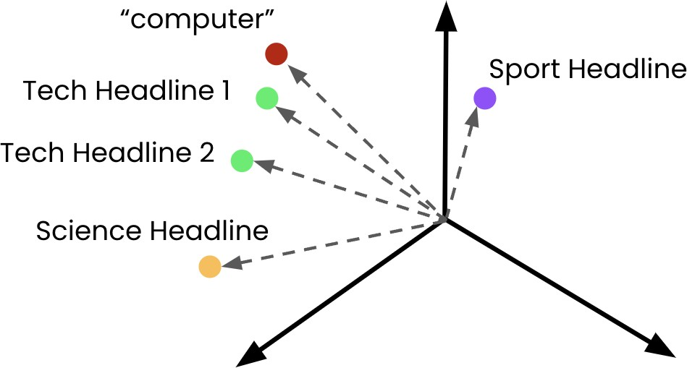
Review 2 - Embeddings for AI Applications
Semantic search and recommendation
Classification

Slide 104
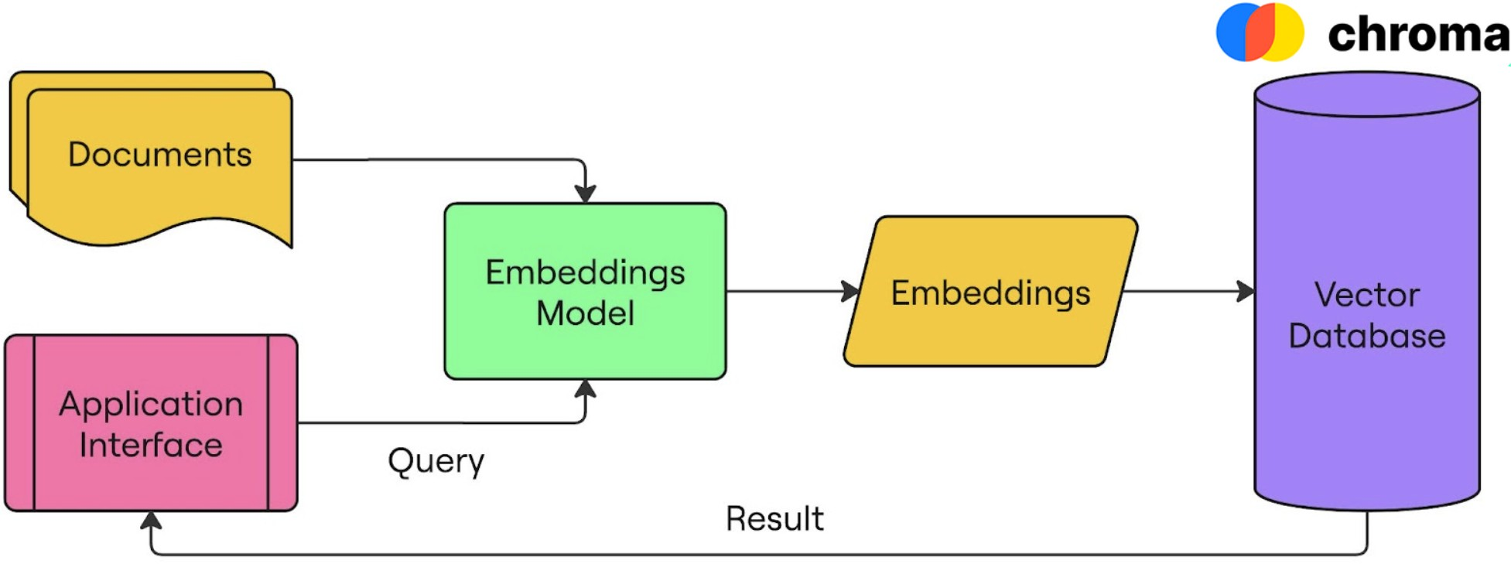
Review 3 - Vector Databases

Slide 105
Dall-E2

Slide 106
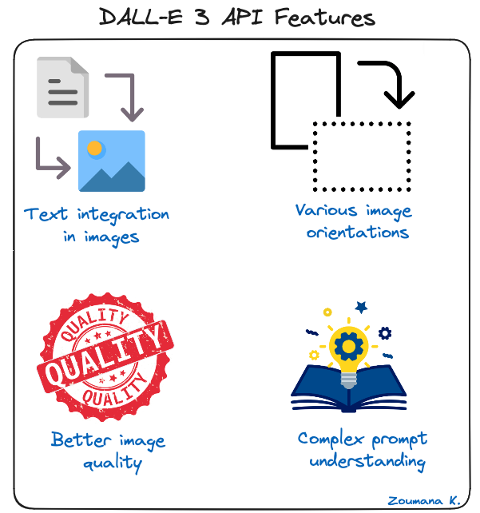
Notes:
A Comprehensive Guide to the DALL-E 3 API
Discover the transformative power of DALL-E 3 API in this guide, covering its key features, industry applications, and tips for users to unlock their creative potential.
Nov 22, 2023 · 14 min read
ContentsAn Overview of DALL-E 3 API
DALL-E 3 API Features
Industry Use-Cases of DALL-E 3 API
Hands-On: Getting Started with DALL-E 3 API
Best Practices When Using DALL-E 3 API
Conclusion
Share
We are now living in a world where creativity has fewer boundaries. Thanks to generative AI capabilities in creating natural language, images, and video, our most vivid imaginations can be transformed into stunning visual realities.
Scuh possibilities seemed like fiction a few years ago, but this is no longer the case, especially with the groundbreaking technology of the DALL-E 3 API.
This article provides a complete guide to understanding the DALL-E 3 technology, exploring its features, hands-on and real-world applications, and how it is reshaping the creative landscape.
An Overview of DALL-E 3 API
Before diving into the API aspect, let’s first understand what DALL-E 3 is. We’ve got a full introduction to using DALL-E 3 via Bing and ChatGPT, whereas this guide will focus mainly on integrating the API.
What is DALL-E 3?
It is OpenAI’s latest image generation model and was announced in September 2023. This model is capable of understanding significantly more nuance and detail than its predecessors. DALL-E 3 allows users to generate exceptional visuals from textual descriptions.
Multiple versions, such as DALL-E 1 and DALL-E 2, have been featured respectively in January 2021, and April 2022. DALL-E 3 is by far the most improved version, and below is the table comparing it to the previous versions.
Pricing details
The pricing details are provided for each one of the DALL-E versions. As we can see, only DALL-E 3 provides standard and high-definition image qualities and their corresponding resolutions.
Model
Quality
Resolution
Price per image (in US $)
DALL-E
1024x1024
0.13
DALL·E 2
1024×1024
0.020
512×512
0.018
256×256
0.016
DALL·E 3
Standard
1024×1024
0.040
1024×1792, 1792×1024
0.080
HD
1024×1024
0.080
1024×1792, 1792×1024
0.120
Additional characteristics
The table above provides a comparative overview of three different iterations of the DALL-E AI system, which is designed to generate images from textual descriptions. These versions are DALL-E, DALL-E 2, and DALL-E 3, each with its own release date and set of features.
DALL-E, the first version, was introduced in January 2021, utilizing GPT-3 as its underlying language model. It marked the initial step in text-to-image generation technology, available to users with an OpenAI API account.
The second version, DALL-E 2, was released in July 2022, advancing the technology with the CLIP language model. CLIP's capabilities enhanced the system's understanding of text prompts, leading to more accurate image generation.
The most recent version is DALL-E 3, which was released in October 2023. It integrates the more advanced GPT-4 language model, likely offering further improved text understanding and image creation. This version is accessible not only to OpenAI API account holders but also to "Plus" subscribers via the ChatGPT interface.
Each version signifies an evolutionary step in text-to-image AI capabilities, with advancements in language models and accessibility reflecting OpenAI's commitment to improving and democratizing AI technology.
OpenAI provides additional capabilities through its “Plus” subscription, and one of them is its GPT-4 Vision. To learn more about this, our GPT-4 Vision: A Comprehensive Guide for Beginners introduces you to everything you need to know about GPT-4 Vision, from accessing it to going hands-on into real-world examples and its limitations.
DALL-E
DALL-E 2
DALL-E 3
Release date
January 2021
July 2022
October 2023
Input data type
Text prompt
Text prompt
Text prompt
Language model
GPT-3
CLIP
GPT-4
Available to
Anyone with an OpenAI API account
Anyone with an OpenAI API account
Anyone with an OpenAI API account and the “Plus“ subscribers via ChatGPT
Why an API Version?
OpenAI announced the launch of several APIs during its first-ever developer day, and DALL-E 3 was one of them.
The API version of DALL-E 3 offers more direct and versatile access to its capabilities. After coming to ChatGPT interface and Bing Chat, which provide a more controlled and guided experience, the API version allows developers and businesses to directly integrate DALL-E 3 capabilities into their own applications and workflows.
DALL-E 3 API Features
The API brings to the table a set of features designed to improve the users’ experience, and let’s explore these capabilities in detail:
DALL-E 3 API features
Text integration in images: DALL-E 3 API can integrate desired text into a visual context, making it look like it was part of the original scene.
Various image orientations: with DALL-E 3, users can generate both landscape and portrait formats of images, ensuring flexibility for different media and layout requirements.
Better image quality: the model is not able to create visually attractive images, but also rich in details, hence providing a realistic and captivating visual experience
Complex prompt understanding: DALL-E 3 is efficient at interpreting complex prompts, allowing users to create highly specific and detailed images.
Industry Use-Cases of DALL-E 3 API
Many industries have been taking advantage of the DALL-E technology since the initial versions. This current API provides more advanced image-generation capabilities, facilitating creativity and efficiency.
Even though there are countless of industries, this section focuses on three of them, such as advertising and marketing, education, and video game development.
Advertising and marketing: Multiple agencies can leverage the API for a quick creation of customized visuals for marketing campaigns and branding. This has the benefit of improving their creativity and reducing time to market.
Education: Online educational platforms can use the API to generate tailored illustrations and diagrams to make their learning materials more engaging and accessible to a broader audience.
Video game development: This is, I believe, one of the fields that will take advantage of the DALL-E 3 API because gaming is all visuals. Game developers can integrate the technology to quickly design unique game visuals.
Hands-On: Getting Started with DALL-E 3 API
Now that we have a better understanding of the DALL-E 3 API and what it’s capable of, let’s get creative. This section focuses on guiding through the process of generating images using the DALL-E 3 API after setting up all the requirements.
Image generation workflow
For any technical implementation, it is better to provide a visual workflow illustrating the interaction between the main components of the overall application being developed.
This workflow explains how the user interacts with the API, from providing the custom prompt to getting the final image.
Simplified workflow of User's Interaction With the DALL-E 3 API
There are two main parts in the workflow:
The front-end is the the part that allows the user to provide the description for the desired image.
The second part is the back-end, which is responsible for mapping the user’s prompt to the DALL-E 3 API.
Now it is time to dive into the technical implementation. The source code for this tutorial is available in this DataLab workbook; create a copy to edit and run it in the browser without installing anything on your computer.
Set Up the OpenAI KEY
The main tools required to successfully reproduce the results of this tutorial are:
Python: this is the main programming language we’ll use for this tutorial. An alternative option is NodeJS.
OpenAI: the package to interact with OpenAI services
OS: the operating system package to configure the environment variable
Image: responsible for converting the DALL-E 3 response into the image format
The first step is to acquire the OpenAI KEY, which helps access the DALL-E 3 model. The main steps are illustrated below:
Four main steps to create an OpenAI KEY
The above main four steps are self-explanatory. However, it is important to create an account from the official OpenAI website.
Interact with DALL-E 3 API
Once you’ve acquired the KEY, make sure not to share it with anyone. The key should remain private. Next, set up the key to the environment variable as follows to be able to work with:
import os OPENAI_API_KEY= “<YOUR PRIVATE KEY>” os.environ["OPENAI_API_KEY"] = OPENAI_API_KEY
Powered By
This os.environ statement initiates the interaction with any OpenAI services depending on the user’s private key scope, which can be Personal or Enterprise.
Then, using the generate function from the OpenAI clients, the user is able to specify:
The model to use, which is dall-e-3 for this tutorial.
The prompt to be sent to the model.
The dimensions of the final image to be generated by the dall-e-3, and we use the same dimension of 1024x1024 for all the images being generated.
The quality of the image, whether it is standard or high definition (hd). Let’s focus on generating only high-definition images.
The user can request one image at time with the DALL-E 3 model or up to ten images at a time using the n parameter, which can be beneficial for parallel requests. This tutorial uses n=1 for simplicity’s sake.
The following helper function combines all the above information for better reproducibility, but before that, we need to install the OpenAI library and import all the required ones:
The installation is performed using the Python package manager pip as follows:
pip install --upgrade openai
Powered By
The upgrade option is to upgrade to the Python SDK v1.2, which is required to successfully interact with DALL-E 3.
from openai import OpenAI # Instantiate the OpenAI client client = OpenAI() from IPython.display import Image
Powered By
The client is responsible for initiating the communication with the DALL-E 3 API.
The helper function is implemented below:
def get_image_from_DALL_E_3_API(user_prompt, image_dimension="1024x1024", image_quality="hd", model="dall-e-3", nb_final_image=1): response = client.images.generate( model = model, prompt = user_prompt, size = image_dimension, quality = image_quality, n=nb_final_image, ) image_url = response.data[0].url display(Image(url=image_url))
Powered By
Generate Realistic Images
With the above helper function, let’s experiment with the image generations using simple and advanced prompts. The advanced prompts uses the illustration of the previous industry use cases.
It is important to note that running the same code multiple times generates different results, and this is due to the “creative” part of the model.
Use simple prompt
Let’s imagine sending the following prompt to the model:
Create an image of a cute brown puppy sitting in a green meadow under a clear blue sky.
puppy_prompt = "Create an image of a cute brown puppy sitting in a green meadow under a clear blue sky." get_image_from_DALL_E_3_API(puppy_prompt)
Powered By
The following image is generated after a successful execution of the above code snippet.
Image generated from the simple prompt
This result is the true reflection of the underlying prompt.
Use more complex prompts
Now, let’s consider the complex prompts for Education, advertisement, and video game development.
Educational Content
Prompt:
Generate an illustration of the solar system with planets orbiting the sun, labeled in English, for a grade school science textbook.
Code:
education_prompt = "Generate an illustration of the solar system with planets orbiting the sun, labeled in English, for a grade school science textbook" get_image_from_DALL_E_3_API(education_prompt)
Powered By
Result:
Image generated for “Education” prompt
Advertising and Marketing
Prompt:
Create an image of a family enjoying a picnic in a futuristic city park, with skyscrapers in the background and a clear blue sky, to be used in a campaign promoting eco-friendly urban living.
Code:
advertising_prompt = "Create an image of a family enjoying a picnic in a futuristic city park, with skyscrapers in the background and a clear blue sky, to be used in a campaign promoting eco-friendly urban living." get_image_from_DALL_E_3_API(advertising_prompt)
Powered By
Result:
Image generated for “Advertising” prompt
Game Development
For this final example, let’s ask the model to add textual information highlighted in orange in the prompt, and let’s see how it behaves.
Prompt:
Design a concept art of a mystical forest at twilight, with glowing plants and a hidden entrance to an underground cave, for an adventure game setting. Include a signpost in the image with the text 'Beware: Mythical Creatures Ahead' in an ancient, mystical font style.
Code:
game_dev_prompt = "Design a concept art of a mystical forest at twilight, with glowing plants and a hidden entrance to an underground cave, for an adventure game setting. Include a signpost in the image with the text 'Beware: Mythical Creatures Ahead' in an ancient, mystical font style" get_image_from_DALL_E_3_API(game_dev_prompt)
Powered By
Result:
Image generated for “Game Development” prompt
We can see that the model was able to successfully add the text “BEWARE MYTHICAL CREATURES AHEAD” after generating the image. That’s just fantastic.
Best Practices When Using DALL-E 3 API
To have a better experience with DALL-E 3 API, here are some best practices and guidelines:
Prioritize detailed communication: Providing precise and detailed prompts to DALL-E 3 is key, just as clear and specific instructions help in human interactions. The more explicit the requests, the more accurate the end result
Ethical considerations: It is important to be mindful of the ethical implications of the final creations by respecting copyright and privacy laws, and considering the potential impact of the generated images.
Acknowledge and adapt to its limitations: Like any technology, DALL-E 3 has its own limitations as well. Familiarizing yourself with what the API can and can not do will help tailor the prompts for more realistic expectations.
Stay informed and evolve: trying a variety of prompts can help discover the API’s range of possibilities and also one’s own creative boundaries. For painters, this is similar to exploring different brushes and colors.
Conclusion
In summary, this article has presented an exhaustive exploration of the DALL-E 3 API, detailing its setup and various applications. We began with an overview of the API, outlining its groundbreaking capabilities and setting the stage for a deeper dive.
We then delved into the specific features of DALL-E 3, providing clarity on its advanced image generation functionalities. This was followed by an insightful look into various industry use cases, demonstrating the API's versatility and wide-ranging impact.
The article also guided through the initial steps of using the DALL-E 3 API, from obtaining access to setting it up for different applications, highlighting the importance of understanding and effectively using the API's features.
Additionally, we discussed best practices for using the DALL-E 3 API, emphasizing ethical considerations and strategies for maximizing its potential. Practical tips, coupled with examples of the API's capabilities, were shared to assist users in optimizing their experience.
Are you ready to take your next step in the world of AI and creative technology? Enhance your skills and unlock your creative potential with the advanced tools used by AI innovators. Embark on your journey with our How to Use Midjourney: A Comprehensive Guide to AI-Generated Artwork Creation tutorial today. Or, learn how to work with other popular APIs, such as our Working with the OpenAI API course.

Slide 107

Notes:
A Comprehensive Guide to the DALL-E 3 API
Discover the transformative power of DALL-E 3 API in this guide, covering its key features, industry applications, and tips for users to unlock their creative potential.
Nov 22, 2023 · 14 min read
ContentsAn Overview of DALL-E 3 API
What is DALL-E 3?
Why an API Version?
DALL-E 3 API Features
Industry Use-Cases of DALL-E 3 API
Hands-On: Getting Started with DALL-E 3 API
Best Practices When Using DALL-E 3 API
Conclusion
Share
We are now living in a world where creativity has fewer boundaries. Thanks to generative AI capabilities in creating natural language, images, and video, our most vivid imaginations can be transformed into stunning visual realities.
Scuh possibilities seemed like fiction a few years ago, but this is no longer the case, especially with the groundbreaking technology of the DALL-E 3 API.
This article provides a complete guide to understanding the DALL-E 3 technology, exploring its features, hands-on and real-world applications, and how it is reshaping the creative landscape.
An Overview of DALL-E 3 API
Before diving into the API aspect, let’s first understand what DALL-E 3 is. We’ve got a full introduction to using DALL-E 3 via Bing and ChatGPT, whereas this guide will focus mainly on integrating the API.
What is DALL-E 3?
It is OpenAI’s latest image generation model and was announced in September 2023. This model is capable of understanding significantly more nuance and detail than its predecessors. DALL-E 3 allows users to generate exceptional visuals from textual descriptions.
Multiple versions, such as DALL-E 1 and DALL-E 2, have been featured respectively in January 2021, and April 2022. DALL-E 3 is by far the most improved version, and below is the table comparing it to the previous versions.
Pricing details
The pricing details are provided for each one of the DALL-E versions. As we can see, only DALL-E 3 provides standard and high-definition image qualities and their corresponding resolutions.
Model
Quality
Resolution
Price per image (in US $)
DALL-E
1024x1024
0.13
DALL·E 2
1024×1024
0.020
512×512
0.018
256×256
0.016
DALL·E 3
Standard
1024×1024
0.040
1024×1792, 1792×1024
0.080
HD
1024×1024
0.080
1024×1792, 1792×1024
0.120
Additional characteristics
The table above provides a comparative overview of three different iterations of the DALL-E AI system, which is designed to generate images from textual descriptions. These versions are DALL-E, DALL-E 2, and DALL-E 3, each with its own release date and set of features.
DALL-E, the first version, was introduced in January 2021, utilizing GPT-3 as its underlying language model. It marked the initial step in text-to-image generation technology, available to users with an OpenAI API account.
The second version, DALL-E 2, was released in July 2022, advancing the technology with the CLIP language model. CLIP's capabilities enhanced the system's understanding of text prompts, leading to more accurate image generation.
The most recent version is DALL-E 3, which was released in October 2023. It integrates the more advanced GPT-4 language model, likely offering further improved text understanding and image creation. This version is accessible not only to OpenAI API account holders but also to "Plus" subscribers via the ChatGPT interface.
Each version signifies an evolutionary step in text-to-image AI capabilities, with advancements in language models and accessibility reflecting OpenAI's commitment to improving and democratizing AI technology.
OpenAI provides additional capabilities through its “Plus” subscription, and one of them is its GPT-4 Vision. To learn more about this, our GPT-4 Vision: A Comprehensive Guide for Beginners introduces you to everything you need to know about GPT-4 Vision, from accessing it to going hands-on into real-world examples and its limitations.
DALL-E
DALL-E 2
DALL-E 3
Release date
January 2021
July 2022
October 2023
Input data type
Text prompt
Text prompt
Text prompt
Language model
GPT-3
CLIP
GPT-4
Available to
Anyone with an OpenAI API account
Anyone with an OpenAI API account
Anyone with an OpenAI API account and the “Plus“ subscribers via ChatGPT
Why an API Version?
OpenAI announced the launch of several APIs during its first-ever developer day, and DALL-E 3 was one of them.
The API version of DALL-E 3 offers more direct and versatile access to its capabilities. After coming to ChatGPT interface and Bing Chat, which provide a more controlled and guided experience, the API version allows developers and businesses to directly integrate DALL-E 3 capabilities into their own applications and workflows.
DALL-E 3 API Features
The API brings to the table a set of features designed to improve the users’ experience, and let’s explore these capabilities in detail:
DALL-E 3 API features
Text integration in images: DALL-E 3 API can integrate desired text into a visual context, making it look like it was part of the original scene.
Various image orientations: with DALL-E 3, users can generate both landscape and portrait formats of images, ensuring flexibility for different media and layout requirements.
Better image quality: the model is not able to create visually attractive images, but also rich in details, hence providing a realistic and captivating visual experience
Complex prompt understanding: DALL-E 3 is efficient at interpreting complex prompts, allowing users to create highly specific and detailed images.
Industry Use-Cases of DALL-E 3 API
Many industries have been taking advantage of the DALL-E technology since the initial versions. This current API provides more advanced image-generation capabilities, facilitating creativity and efficiency.
Even though there are countless of industries, this section focuses on three of them, such as advertising and marketing, education, and video game development.
Advertising and marketing: Multiple agencies can leverage the API for a quick creation of customized visuals for marketing campaigns and branding. This has the benefit of improving their creativity and reducing time to market.
Education: Online educational platforms can use the API to generate tailored illustrations and diagrams to make their learning materials more engaging and accessible to a broader audience.
Video game development: This is, I believe, one of the fields that will take advantage of the DALL-E 3 API because gaming is all visuals. Game developers can integrate the technology to quickly design unique game visuals.
Hands-On: Getting Started with DALL-E 3 API
Now that we have a better understanding of the DALL-E 3 API and what it’s capable of, let’s get creative. This section focuses on guiding through the process of generating images using the DALL-E 3 API after setting up all the requirements.
Image generation workflow
For any technical implementation, it is better to provide a visual workflow illustrating the interaction between the main components of the overall application being developed.
This workflow explains how the user interacts with the API, from providing the custom prompt to getting the final image.
Simplified workflow of User's Interaction With the DALL-E 3 API
There are two main parts in the workflow:
The front-end is the the part that allows the user to provide the description for the desired image.
The second part is the back-end, which is responsible for mapping the user’s prompt to the DALL-E 3 API.
Now it is time to dive into the technical implementation. The source code for this tutorial is available in this DataLab workbook; create a copy to edit and run it in the browser without installing anything on your computer.

Slide 108

Notes:
Set Up the OpenAI KEY
The main tools required to successfully reproduce the results of this tutorial are:
Python: this is the main programming language we’ll use for this tutorial. An alternative option is NodeJS.
OpenAI: the package to interact with OpenAI services
OS: the operating system package to configure the environment variable
Image: responsible for converting the DALL-E 3 response into the image format
The first step is to acquire the OpenAI KEY, which helps access the DALL-E 3 model. The main steps are illustrated below:

Slide 109



Slide 110
Project

Slide 111


Thank You for joining us!
We truly appreciate your time. Please complete the End of Course Survey.
Any questions?
Review the full Course Guide for Course Tips, Resources & Next Step Learning Plans
Feel Free to Reach Out: Info@triveratech.com
See our full list of Courses & SkillJourneys: www.triveratech.com
Free Courses, Articles, Resources & Offers
Follow Us for Free Courses, Articles, Resources & Offers: LinkedIn: @TriveraTech
Subscribe to our Channel for Free Courses & Events: YouTube: @TriveraTech

